Slide 1
Docker
Docker is an excellent tool for managing and deploying microservices.
Each microservice can be further broken down into processes running in separate Docker containers, which can be specified with Dockerfiles and Docker Compose configuration files.
Combined with a provisioning tool such as Kubernetes, each microservice can then be easily deployed, scaled, and collaborated on by a developer team.
Specifying an environment in this way also makes it easy to link microservices together to form a larger application.

Slide 2
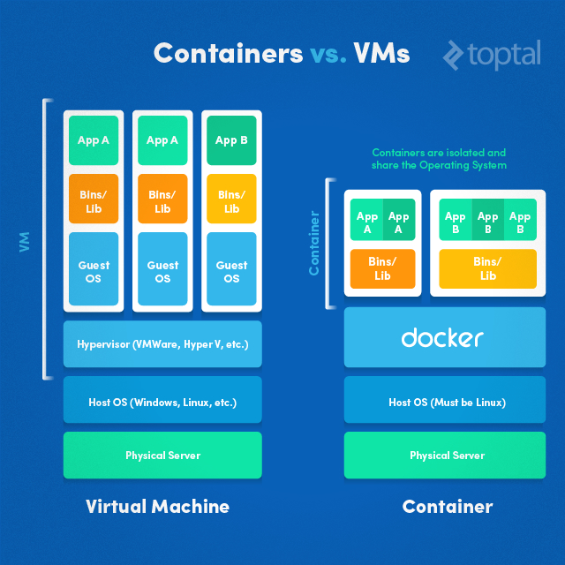
Docker

Slide 3
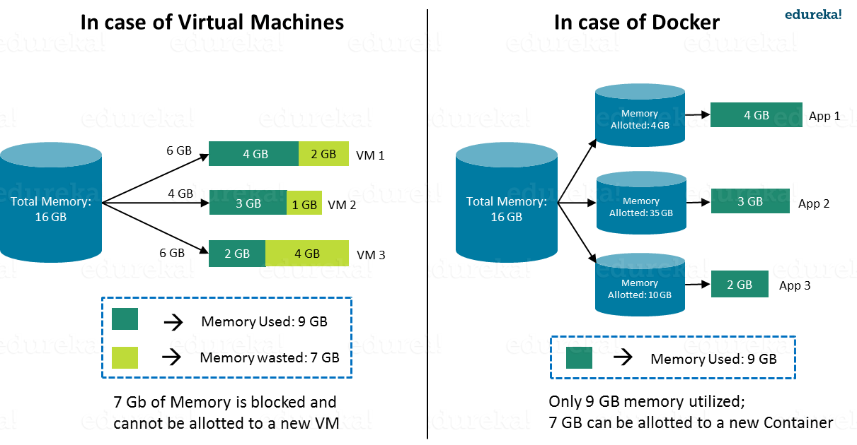

Slide 4
Hypervisor
A hypervisor is a software that makes virtualization possible.
It is also called Virtual Machine Monitor.
It divides the host system and allocates the resources to each divided virtual environment.

Slide 5
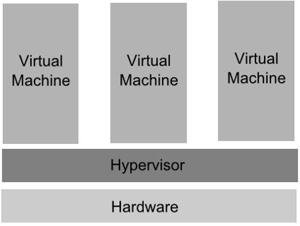
Hypervisor

Slide 6
Hypervisor
Hyper-V will only run on processors which support hardware assisted virtualization.
The x86 family of CPUs provide a range of protection levels also known as rings in which code can execute.
Ring 0 has the highest level privilege and it is in this ring that the operating system kernel normally runs.
Code executing in ring 0 is said to be running in system space, kernel mode or supervisor mode.
All other code, such as applications running on the operating system, operate in less privileged rings, typically ring 3.

Slide 7
Hypervisor
Under Hyper-V hypervisor virtualization a program known as a hypervisor runs directly on the hardware of the host system in ring 0.
The task of this hypervisor is to handle tasks such CPU and memory resource allocation for the virtual machines in addition to providing interfaces for higher level administration and monitoring tools.

Slide 8
Hypervisor
If the hypervisor is going to occupy ring 0 of the CPU, the kernels for any guest operating systems running on the system must run in less privileged CPU rings.
Unfortunately, most operating system kernels are written explicitly to run in ring 0 for the simple reason that they need to perform tasks that are only available in that ring, such as the ability to execute privileged CPU instructions and directly manipulate memory.

Slide 9
Hypervisor
One solution to this problem is to modify the guest operating systems, replacing any privileged operations that will only run in ring 0 of the CPU with calls to the hypervisor (known as hypercalls).
The hypervisor in turn performs the task on behalf of the guest system.

Slide 10
Hypervisor
Another solution is to leverage the hardware assisted virtualization features of the latest generation of processors from both Intel and AMD.
These technologies, known as Intel VT and AMD-V respectively, provide extensions necessary to run unmodified guest virtual machines.
These new processors provide an additional privilege mode (referred to as ring -1) above ring 0 in which the hypervisor can operate, essentially leaving ring 0 available for unmodified guest operating systems.

Slide 11
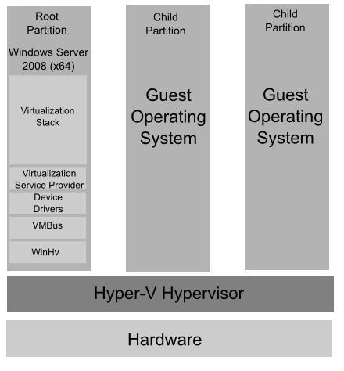
Hyper-V Root and Child Partitions

Slide 12
Hyper-V Root and Child Partitions
The root partition is essentially a virtual machine which runs a copy of 64-bit Windows Server 2008 which, in turn, acts as a host for a number of special Hyper-V components.
The root partition is responsible for providing the device drivers for the virtual machines running in the child partitions, managing the child partition lifecycles, power management and event logging.
The root partition operating system also hosts the Virtualization Stack which is responsible for performing a wide range of virtualization functions.
Child partitions host the virtual machines in which the guest operating systems run. Hyper-V supports both Hyper-V Aware (also referred to as enlightened) and Hyper-V Unaware guest operating systems.

Slide 13
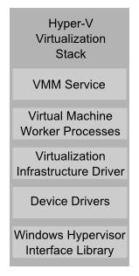
The Virtualization Stack and Other Root Partition Components

Slide 14
The Virtualization Stack and Other Root Partition Components
Component | Description
Virtual Machine Management Service (VMM Service) | Manages the state of virtual machines running in the child partitions (active, offline, stopped etc) and controls the tasks that can be performed on a virtual machine based on current state (such as taking snapshots). Also manages the addition and removal of devices. When a virtual machine is started, the VMM Service is also responsible for creating a corresponding Virtual Machine Worker Process.
Virtual Machine Worker Process | Virtual Machine Worker Processes are started by the VMM Service when virtual machines are started. A Virtual Machine Worker Process (named vmwp.exe) is created for each Hyper-V virtual machine and is responsible for much of the management level interaction between the parent partition Windows Server 2008 system and the virtual machines in the child partitions. The duties of the Virtual Machine Worker Process include creating, configuring, running, pausing, resuming, saving, restoring and snapshotting the associated virtual machine. It also handles IRQs, memory and I/O port mapping through a Virtual Motherboard (VMB).

Slide 15
The Virtualization Stack and Other Root Partition Components
Component | Description
Virtual Devices | Virtual Devices are managed by the Virtual Motherboard (VMB). Virtual Motherboards are contained within the Virtual Machine Worker Processes, of which there is one for each virtual machine. Virtual Devices fall into two categories, Core VDevs and Plug-in VDevs. Core VDevs can either be Emulated Devices or Synthetic Devices.
Virtual Infrastructure Driver | Operates in kernel mode (i.e. in the privileged CPU ring) and provides partition, memory and processor management for the virtual machines running in the child partitions. The Virtual Infrastructure Driver (Vid.sys) also provides the conduit for the components higher up the Virtualization Stack to communicate with the hypervisor.

Slide 16
The Virtualization Stack and Other Root Partition Components
Component | Description
Windows Hypervisor Interface Library | A DLL (named WinHv.sys) located in the parent partition Windows Server 2008 instance and any guest operating systems which are Hyper-V aware (in other words modified specifically to operate in a Hyper-V child partition). Allows the operating system's drivers to access the hypervisor using standard Windows API calls instead of hypercalls.
VMBus | Part of Hyper-V Integration Services, the VMBus facilitates highly optimized communication between child partitions and the parent partition

Slide 17
The Virtualization Stack and Other Root Partition Components
Component | Description
Virtualization Service Providers | Resides in the parent partition and provides synthetic device support via the VMBus to Virtual Service Clients (VSCs) running in child partitions.
Virtualization Service Clients | Virtualization Service Clients are synthetic device instances that reside in child partitions. They communicate with the VSPs in the parent partition over the VMBus to fulfill the child partition's device access requests.

Slide 18
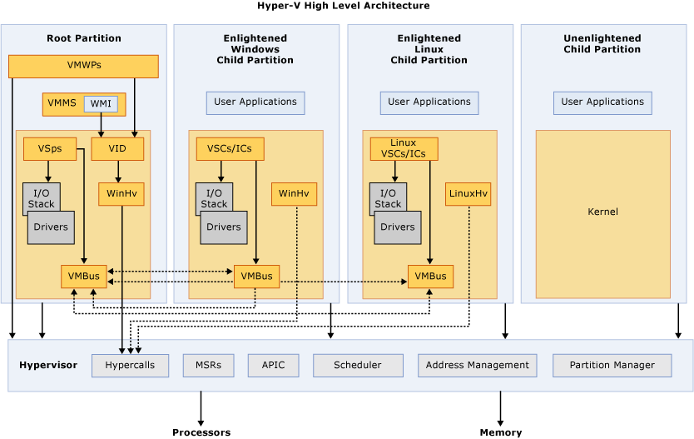
Hyper-V Architecture

Slide 19
Hyper-V Architecture
APIC – Advanced Programmable Interrupt Controller – A device which allows priority levels to be assigned to its interrupt outputs.
Child Partition – Partition that hosts a guest operating system - All access to physical memory and devices by a child partition is provided via the Virtual Machine Bus (VMBus) or the hypervisor.
Hypercall – Interface for communication with the hypervisor - The hypercall interface accommodates access to the optimizations provided by the hypervisor.

Slide 20
Hyper-V Architecture
Hypervisor – A layer of software that sits between the hardware and one or more operating systems. Its primary job is to provide isolated execution environments called partitions. The hypervisor controls and arbitrates access to the underlying hardware.
IC – Integration component – Component that allows child partitions to communication with other partitions and the hypervisor.
I/O stack – Input/output stack
MSR – Memory Service Routine

Slide 21
Hyper-V Architecture
Root Partition – Sometimes called parent partition. Manages machine-level functions such as device drivers, power management, and device hot addition/removal. The root (or parent) partition is the only partition that has direct access to physical memory and devices.
VID – Virtualization Infrastructure Driver – Provides partition management services, virtual processor management services, and memory management services for partitions.

Slide 22
Hyper-V Architecture
VMBus – Channel-based communication mechanism used for inter-partition communication and device enumeration on systems with multiple active virtualized partitions. The VMBus is installed with Hyper-V Integration Services.
VMMS – Virtual Machine Management Service – Responsible for managing the state of all virtual machines in child partitions.
VMWP – Virtual Machine Worker Process – A user mode component of the virtualization stack.
The worker process provides virtual machine management services from the Windows Server 2008 instance in the parent partition to the guest operating systems in the child partitions.
The Virtual Machine Management Service spawns a separate worker process for each running virtual machine.

Slide 23
Hyper-V Architecture
VSC – Virtualization Service Client – A synthetic device instance that resides in a child partition.
VSCs utilize hardware resources that are provided by Virtualization Service Providers (VSPs) in the parent partition.
They communicate with the corresponding VSPs in the parent partition over the VMBus to satisfy a child partitions device I/O requests.
VSP – Virtualization Service Provider – Resides in the root partition and provide synthetic device support to child partitions over the Virtual Machine Bus (VMBus).

Slide 24
Hyper-V Architecture
WinHv – Windows Hypervisor Interface Library - WinHv is essentially a bridge between a partitioned operating system’s drivers and the hypervisor which allows drivers to call the hypervisor using standard Windows calling conventions
WMI – The Virtual Machine Management Service exposes a set of Windows Management Instrumentation (WMI)-based APIs for managing and controlling virtual machines.

Slide 25
hyper-v containers
Windows Hyper-v container is a windows server container that runs in a VM.
Every hyper-v container creates its own VM.
This means that there is no kernel sharing between the different hyper-v containers.
This is useful for cases where additional level of isolation is needed by customers who don’t like the traditional kernel sharing done by containers.
The same Docker image and CLI can be used to manage hyper-v containers.
Creation of hyper-v containers is specified as a runtime option.
There is no difference when building or managing containers between windows server and hyper-v container.
Startup times for hyper-v container is higher than windows native container since a new lightweight VM gets created each time.

Slide 26
hyper-v containers
Creation of hyper-v containers is specified as a runtime option.
There is no difference when building or managing containers between windows server and hyper-v container.
Startup times for hyper-v container is higher than windows native container since a new lightweight VM gets created each time.

Slide 27
hyper-v containers
There are 2 modes of hyper-v container.
Windows hyper-v container – Here, hyper-v container runs on top of Windows kernel. Only Windows containers can be run in this mode.
Linux hyper-v container – Here, hyper-v container runs on top of Linux kernel. This mode was not available earlier and it was introduced as part of Dockercon 2017. Any Linux flavor can be used as the base kernel. Docker’s Linuxkit project can be used to build the Linux kernel needed for the hyper-v container. Only Linux containers can be run in this mode.

Slide 28
hyper-v containers
We cannot use Docker Toolbox and hyper-v containers at the same time. Virtualbox cannot run when “Docker for Windows” is installed.
https://nickjanetakis.com/blog/should-you-use-the-docker-toolbox-or-docker-for-mac-windows

Slide 29
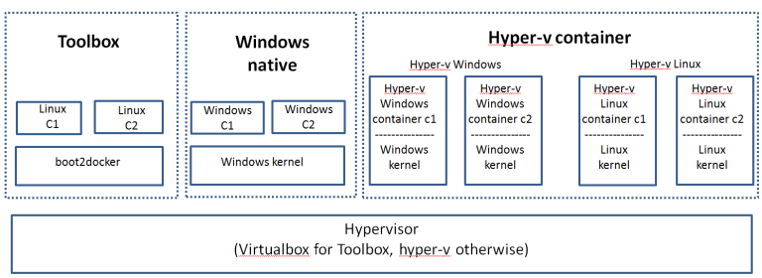
Docker

Slide 30
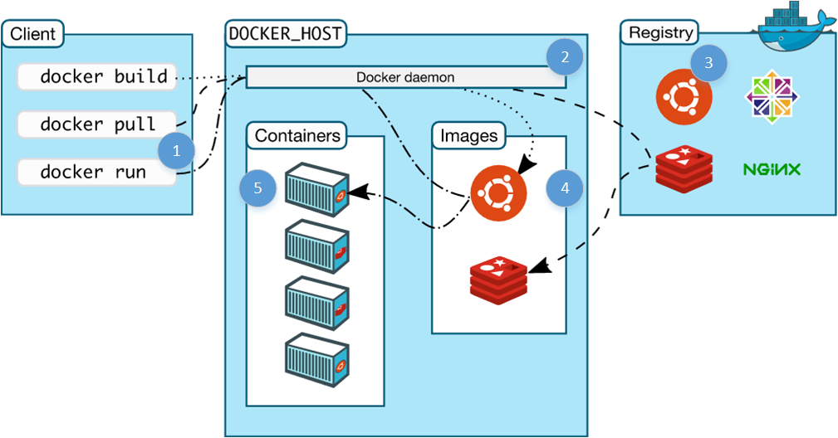
Docker Architecture

Slide 31
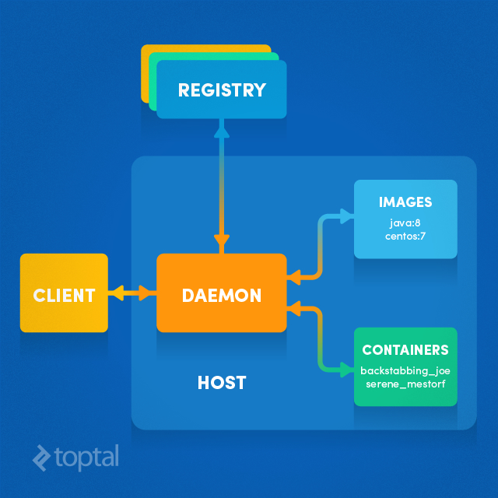
Docker Architecture

Slide 32

Docker Engine

Slide 33
Dockerfile, Docker Image And Docker Container:
A Docker Image is created by the sequence of commands written in a file called as Dockerfile.
When this Dockerfile is executed using a docker command it results into a Docker Image with a name.
When this Image is executed by “docker run” command it will by itself start whatever application or service it must start on its execution.

Slide 34
Image Demo
https://learnk8s.io/spring-boot-kubernetes-guide

Slide 35
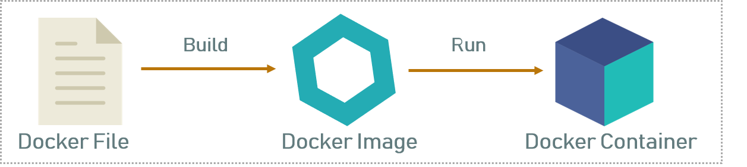

Slide 36
Docker Network
Docker implements networking in an application-driven manner and provides various options while maintaining enough abstraction for application developers.
There are basically two types of networks available - the default Docker network and user-defined networks.
By default, you get three different networks on the installation of Docker - none, bridge, and host.

Slide 37
Docker Network
The none and host networks are part of the network stack in Docker.
The bridge network automatically creates a gateway and IP subnet and all containers that belong to this network can talk to each other via IP addressing.
This network is not commonly used as it does not scale well and has constraints in terms of network usability and service discovery.

Slide 38
Docker Network
The other type of networks is user-defined networks. Administrators can configure multiple user-defined networks.
There are three types:
Bridge network: Similar to the default bridge network, a user-defined Bridge network differs in that there is no need for port forwarding for containers within the network to communicate with each other.
The other difference is that it has full support for automatic network discovery.

Slide 39
Docker Network
Overlay network: An Overlay network is used when you need containers on separate hosts to be able to communicate with each other, as in the case of a distributed network.
However, a caveat is that swarm mode must be enabled for a cluster of Docker engines, known as a swarm, to be able to join the same group.
Macvlan network: When using Bridge and Overlay networks a bridge resides between the container and the host.
A Macvlan network removes this bridge, providing the benefit of exposing container resources to external networks without dealing with port forwarding.
This is realized by using MAC addresses instead of IP addresses.

Slide 40
Storage
You can store data within the writable layer of a container but it requires a storage driver.
Being non-persistent, it perishes whenever the container is not running.
It is not easy to transfer this data.
In terms of persistent storage, Docker offers four options:
Data Volume, Data Volume Container, Directory Mounts, Storage Plugins

Slide 41
Storage
There are storage plugins from various companies to automate the storage provisioning process. For example,
HPE 3PAR
EMC (ScaleIO, XtremIO, VMAX, Isilon)
NetApp
There are also plugins that support public cloud providers like:
Azure File Storage
Google Compute Platform.

Slide 42
Registries
A Docker registry is a storage and distribution system for named Docker images.
The same image might have multiple different versions, identified by their tags.
A Docker registry is organized into Docker repositories , where a repository holds all the versions of a specific image.
The registry allows Docker users to pull images locally, as well as push new images to the registry (given adequate access permissions when applicable).

Slide 43
Registries
By default, the Docker engine interacts with DockerHub , Docker's public registry instance.
However, it is possible to run on-premise the open-source Docker registry/distribution, as well as a commercially supported version called Docker Trusted Registry .

Slide 44
Docker Hub
DockerHub is a hosted registry solution by Docker Inc.
Besides public and private repositories, it also provides automated builds, organization accounts, and integration with source control solutions like Github and Bitbucket .

Slide 45
Docker Hub
A public repository is accessible by anyone running Docker, and image names include the organization/user name.
For example, docker pull jenkins/jenkins will pull the Jenkins CI server image with tag latest from the Jenkins organization.
There are hundreds of thousands public images available.
Private repositories restrict access to the repository creator or members of its organization.

Slide 46
Docker Hub
DockerHub supports official repositories, which include images verified for security and best practices.
These do not require an organization/user name, for example docker pull nginx will pull the latest image of the Nginx load balancer.
DockerHub can perform automated image builds if the DockerHub repository is linked to a source control repository which contains a build context (Dockerfile and all any files in the same folder).
A commit in the source repository will trigger a build in DockerHub.

Slide 47
Other Public Registries
Other companies host paid online Docker registries for public use.
Cloud providers like AWS and Google, who also offer container-hosting services, market the high availability of their registries.

Slide 48
Other Public Registries
Amazon Elastic Container Registry (ECR) integrates with AWS Identity and Access Management (IAM) service for authentication. It supports only private repositories and does not provide automated image building.
Google Container Registry (GCR) authentication is based on Google’s Cloud Storage service permissions. It supports only private repositories and provides automated image builds via integration with Google Cloud Source Repositories, GitHub, and Bitbucket.

Slide 49
Other Public Registries
Azure Container Registry (ACR) supports multi-region registries and authenticates with Active Directory. It supports only private repositories and does not provide automated image building.
CoreOS Quay supports OAuth and LDAP authentication. It offers both (paid) private and (free) public repositories, automatic security scanning and automated image builds via integration with GitLab, GitHub, and Bitbucket.
Private Docker Registry supports OAuth, LDAP and Active Directory authentication. It offers both private and public repositories, free up to 3 repositories (private or public).

Slide 50
Private Registries
Use cases for running a private registry on-premise (internal to the organization) include:
Distributing images inside an isolated network (not sending images over the Internet)
Creating faster CI/CD pipelines (pulling and pushing images from internal network), including faster deployments to on-premise environments
Deploying a new image over a large cluster of machines
Tightly controlling where images are being stored

Slide 51
Private Registries
Running a private registry system, especially when delivery to production depends on it, requires operational skills such as ensuring availability, logging and log processing, monitoring, and security.
Strong understanding of http and overall network communications is also important.

Slide 52
Private Registries
Docker Trusted Registry is Docker Inc’s commercially supported version, providing high availability via replication, image auditing, signing and security scanning, integration with LDAP and Active Directory.
Harbor is a VMWare open source offering which also provides high availability via replication, image auditing, integration with LDAP and Active Directory.
GitLab Container Registry is tightly integrated with GitLab CI’s workflow, with minimal setup.
JFrog Artifactory for strong artifact management (not only Docker images but any artifact).

Slide 53
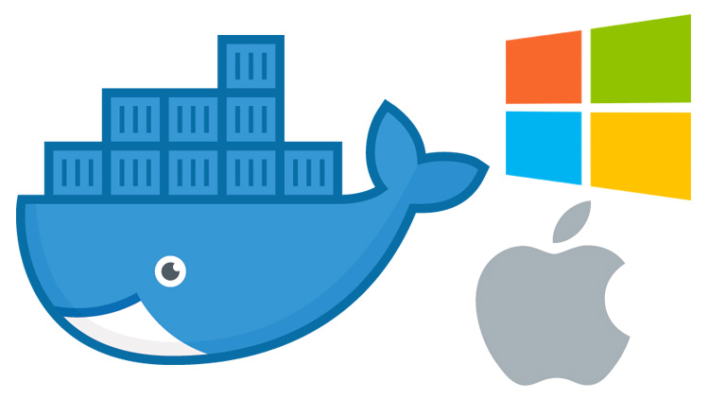
Should You Install Docker with the Docker Toolbox or Docker for Mac / Windows?

Slide 54
Should You Install Docker with the Docker Toolbox or Docker for Mac / Windows?
If you’re on MacOS or Windows you can install Docker with:
Docker for Mac / Windows (now known as Docker Desktop)
Docker Toolbox
Running your own Virtual Machine and installing Docker yourself

Slide 55
Should You Install Docker with the Docker Toolbox or Docker for Mac / Windows?
If you’re on MacOS or Windows you can install Docker with:
Docker for Mac / Windows (now known as Docker Desktop)
Docker Toolbox
Running your own Virtual Machine and installing Docker yourself

Slide 56
Docker for Mac / Docker for Windows (Docker Desktop)
Pros
Offers the most “native” experience, you can easily use any terminal you you want since Docker is effectively running on localhost from MacOS / Windows’ POV.
Docker is heavily developing and polishing this solution.

Slide 57
Docker for Mac / Docker for Windows (Docker Desktop)
Cons
On certain MacOS hardware combos the volume performance can be a little slow.
I can legit say there are not any “wow this sucks!” cons for Windows, it’s really solid.

Slide 58
Docker Toolbox
Pros
Offers an “out of the box” Docker experience if you have no other choice.

Slide 59
Docker Toolbox
Cons
You need to either use the Docker Quickstart Terminal, or configure your own terminal to connect to the Docker Daemon running a VM.
Not a native solution, so you’ll need to access your Docker Machine’s IP address if you’re developing web apps. Example: 192.168.99.100 instead of localhost.

Slide 60
Docker Toolbox
Cons
Unless you jump through hoops, your code needs to live in your Windows user directory such as C:\Users\eswari\src\myapp. Otherwise Docker won’t be able to find it.
Suffers from typical VirtualBox edge case bugs and mount performance issues.

Slide 61
What is Docker
What is Docker?
At its heart, Docker is software which lets you create an image and then run instances of that image in a container.
Docker maintain a vast repository of images, called the Docker Hub which you can use as starting points or as free storage for your own images.
You can install Docker, choose an image you'd like to use, then run an instance of it in a container.

Slide 62
Difference between VM and Container
Applications running in virtual machines, apart from the hypervisor, require a full instance of the operating system and any supporting libraries.
Containers, on the other hand, share the operating system with the host.
Hypervisor is comparable to the container engine (represented as Docker on the image) in a sense that it manages the lifecycle of the containers.
The important difference is that the processes running inside the containers are just like the native processes on the host, and do not introduce any overheads associated with hypervisor execution.
Additionally, applications can reuse the libraries and share the data between containers.

Slide 63
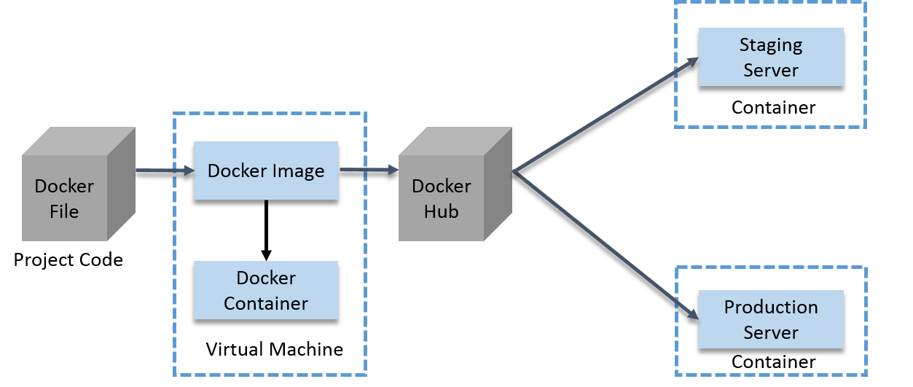

Slide 64
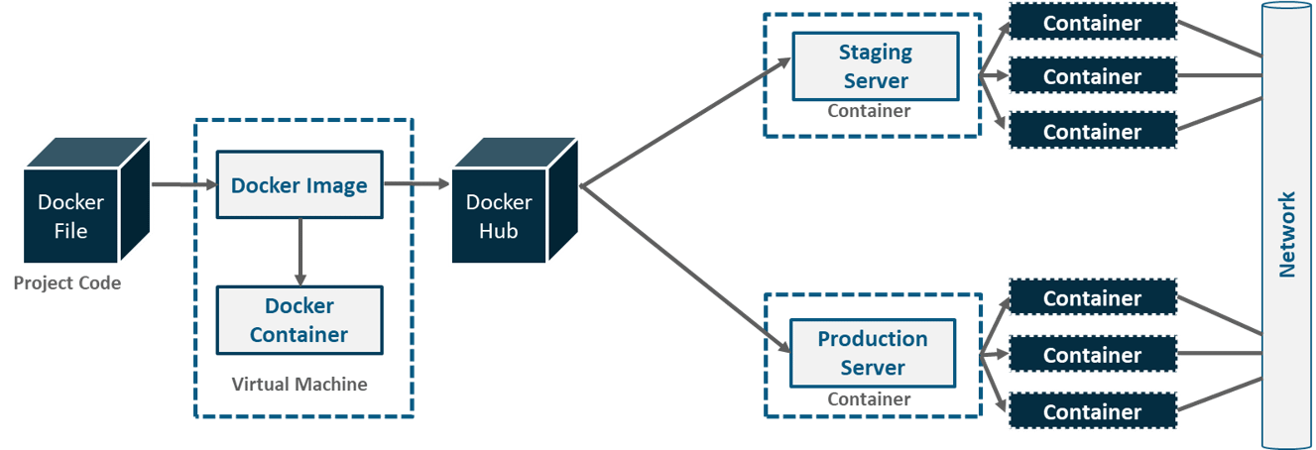

Slide 65
Docker Hub:
Docker Hub is like GitHub for Docker Images. It is basically a cloud registry where you can find Docker Images uploaded by different communities, also you can develop your own image and upload on Docker Hub, but first, you need to create an account on DockerHub.

Slide 66
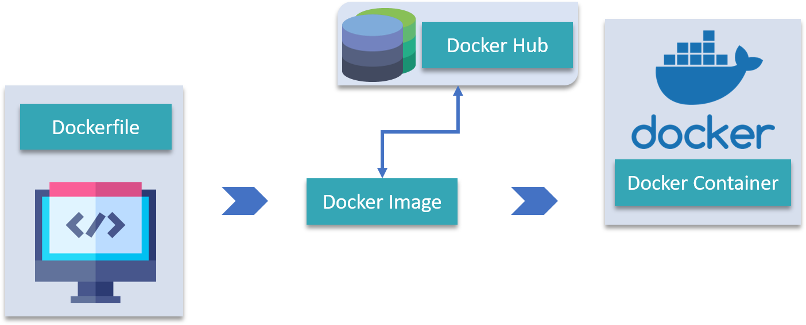
Docker Hub

Slide 67
Docker Architecture
It consists of a Docker Engine which is a client-server application with three major components:
A server which is a type of long-running program called a daemon process (the docker command).
A REST API which specifies interfaces that programs can use to talk to the daemon and instruct it what to do.
A command line interface (CLI) client (the docker command).
The CLI uses the Docker REST API to control or interact with the Docker daemon through scripting or direct CLI commands. Many other Docker applications use the underlying API and CLI.

Slide 68
Docker Architecture
By default, the main registry is the Docker Hub which hosts public and official images.
Organizations can also host their private registries if they desire.
Images can be downloaded from registries explicitly (docker pull imageName) or implicitly when starting a container. Once the image is downloaded it is cached locally.
Containers are the instances of images - they are the living thing. There could be multiple containers running based on the same image.

Slide 69
Docker Architecture
At the center, there is the Docker daemon responsible for creating, running, and monitoring containers.
It also takes care of building and storing images.
Finally, on the left-hand side there is a Docker client. It talks to the daemon via HTTP.
Unix sockets are used when on the same machine, but remote management is possible via HTTP based API.

Slide 70
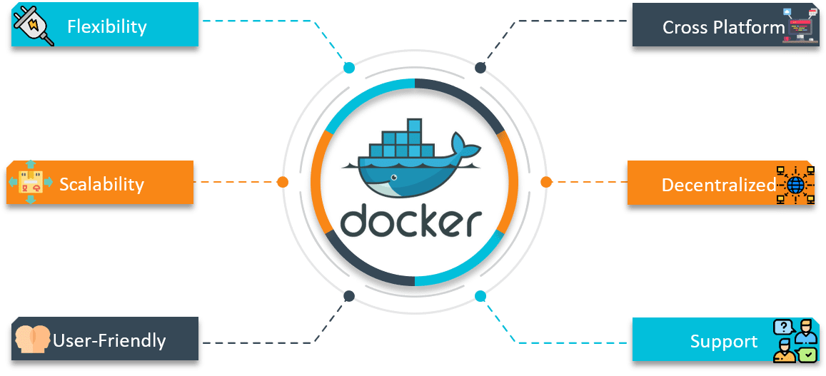
Goals of Docker Networking

Slide 71
Creating Test Database Server
This is a great Docker use case.
We might not want to run our production database in Docker (perhaps we'll just use Amazon RDS for example), but we can spin up a clean MySQL database in no time as a Docker container for development - leaving our development machine clean and keeping everything we do controlled and repeatable.

Slide 72
Docker Compose
Docker Compose is basically used to run multiple Docker Containers as a single server. Let me give you an example:
Suppose if I have an application which requires WordPress, Maria DB and PHP MyAdmin. I can create one file which would start both the containers as a service without the need to start each one separately. It is really useful especially if you have a microservice architecture.

Slide 73
Docker Container
Column | Description
Container ID | The unique ID of the container. It is a SHA-256.
Image | The name of the container image from which this container is instantiated.
Status | The status of the container (created, restarting, running, removing, paused, exited, or dead).
Ports | The list of container ports that have been mapped to the host.
Names | The name assigned to this container (multiple names are possible).

Slide 74
Docker Client and Docker Engine
Docker Client : This is the utility we use when we run any docker commands e.g. docker run (docker container run) , docker images , docker ps etc. It allows us to run these commands which a human can easily understand.
Docker Daemon/Engine: This is the part which does rest of the magic and knows how to talk to the kernel, makes the system calls to create, operate and manage containers, which we as users of docker dont have to worry about.

Slide 75
Creating Test Database Server
docker run --name olddb -e MYSQL_ROOT_PASSWORD=vignesh –e MYSQL_DATABASE=virtusa_2018db –e MYSQL_USER=root -p 3306:3306 mysql/mysql-server:5.5
docker run tells the engine we want to run an image (the image comes at the end, mysql:vlatest
--name db names this container db.
-d detach - i.e. run the container in the background.
-e MYSQL_ROOT_PASSWORD=123 the -e is the flag that tells docker we want to provide an environment variable. The variable following it is what the MySQL image checks for setting the default root password.
-p 3306:3306 tells the engine that we want to map the port 3306 from inside the container to out port 3306.

Slide 76
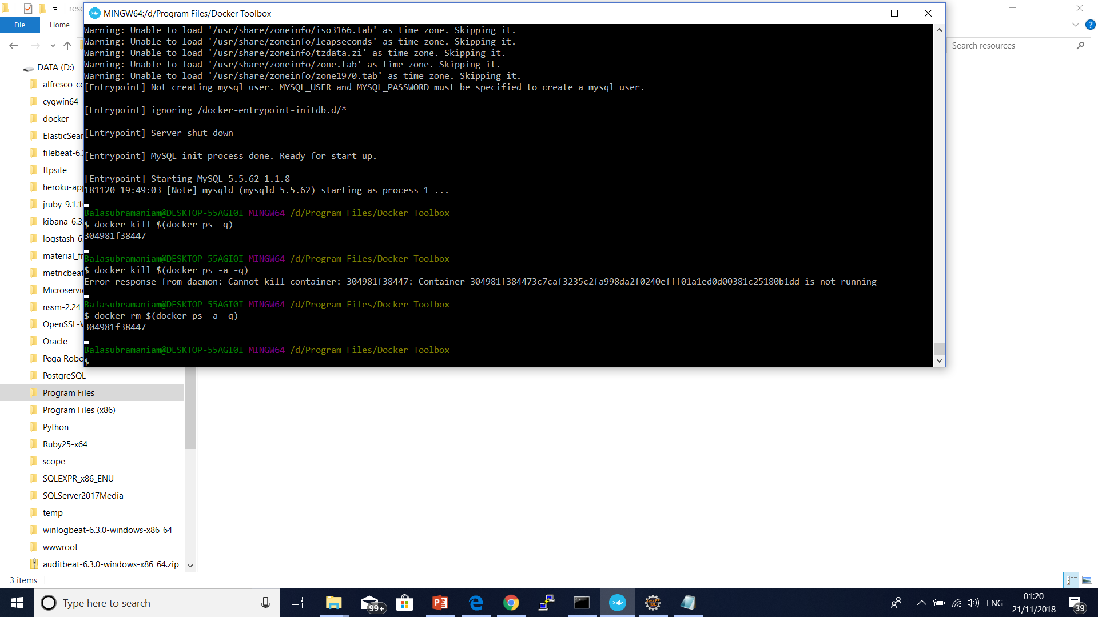

Slide 77
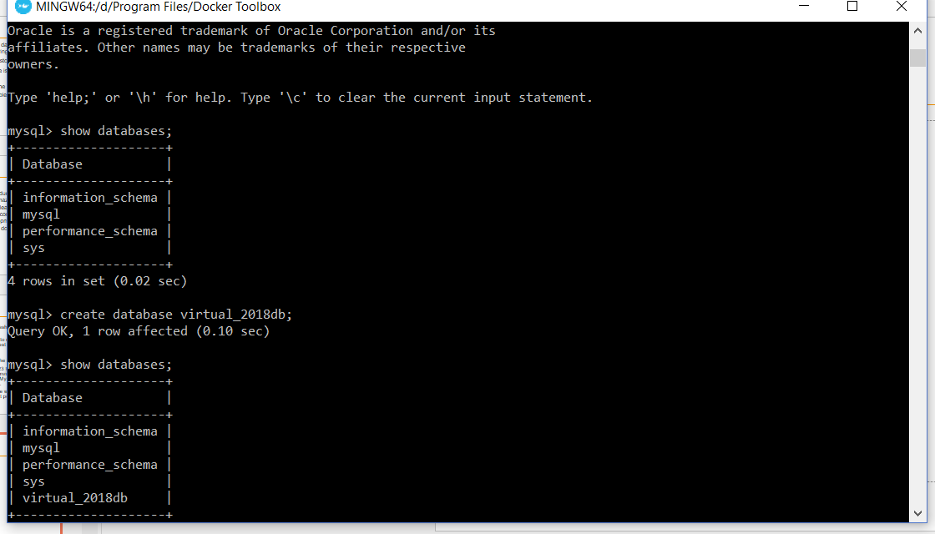
Creating Test Database Server
Docker ps
docker exec -it olddb /bin/bash
mysql –u root –p

Slide 78
Springboot Docker
<plugin>
<groupId>com.spotify</groupId>
<artifactId>docker-maven-plugin</artifactId>
<version>VERSION GOES HERE</version>
<configuration>
<imageName>example</imageName>
<baseImage>java</baseImage>
<entryPoint>["java", "-jar", "/${project.build.finalName}.jar"]</entryPoint>
<!-- copy the service's jar file from target into the root directory of the image -->
<resources>
<resource>
<targetPath>/</targetPath>
<directory>${project.build.directory}</directory>
<include>${project.build.finalName}.jar</include>
</resource>
</resources>
</configuration>
</plugin>

Slide 79
Best practices for writing Dockerfiles
Docker builds images automatically by reading the instructions from a Dockerfile -- a text file that contains all commands, in order, needed to build a given image.
A Dockerfile adheres to a specific format and set of instructions which you can find at Dockerfile reference.
A Docker image consists of read-only layers each of which represents a Dockerfile instruction.
The layers are stacked and each one is a delta of the changes from the previous layer.

Slide 80
Best practices for writing Dockerfiles
FROM ubuntu:18.04
COPY . /app
RUN make /app
CMD python /app/app.py
FROM creates a layer from the ubuntu:18.04 Docker image.
COPY adds files from your Docker client’s current directory.
RUN builds your application with make.
CMD specifies what command to run within the container.

Slide 81
Best practices for writing Dockerfiles
https://docs.docker.com/develop/develop-images/dockerfile_best-practices/

Slide 82
Springboot Docker
Spring boot Project Build
Goal package docker:build
mvn clean install dockerfile:build
Docker folder created and docker image name example deployed in docker machine
Check docker images
Docker ps

Slide 83
Springboot Docker
Docker run –t –name sampleapp –link v1db –p 8080:8080 example:latest
Example:latest --- image name
--name – container reference
--link – db ref in container
docker run -h 192.168.99.100 -p 7070:7070 -t my-repo/example --name my-repo-image:latest

Slide 84
Docker Volume
Volumes are the preferred mechanism for persisting data generated by and used by Docker containers.
While bind mounts are dependent on the directory structure of the host machine, volumes are completely managed by Docker.

Slide 85
Docker Volume
Volumes have several advantages over bind mounts:
Volumes are easier to back up or migrate than bind mounts.
You can manage volumes using Docker CLI commands or the Docker API.
Volumes work on both Linux and Windows containers.
Volumes can be more safely shared among multiple containers.
Volume drivers let you store volumes on remote hosts or cloud providers, to encrypt the contents of volumes, or to add other functionality.
New volumes can have their content pre-populated by a container

Slide 86
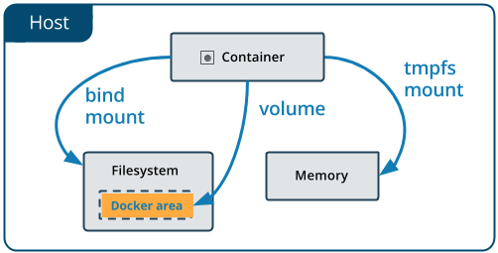

Slide 87
Manage Data in Docker
There are 2 ways in which you can manage data in Docker:
Data volumes
Data volume containers

Slide 88
Manage Data in Docker
A data volume is a specially designed directory in the container.
It is initialized when the container is created.
By default, it is not deleted when the container is stopped.
It is not even garbage collected when there is no container referencing the volume.
The data volumes are independently updated.
Data volumes can be shared across containers too. They could be mounted in read-only mode too.

Slide 89
Manage Data in Docker
Mounting a Data volume
docker container run -it -v/udata --tty ubuntu /bin/bash
cd udata
touch file1.txt
exit
docker container restart 2eec01eb7368
docker attach 2eec01eb7368exit
docker container rm 2eec01eb7368
docker volume ls

Slide 90
Manage Data in Docker
After removing container also the data volume is still present on the host.
This is a dangling or ghost volume and could remain there on your machine consuming space.
Do remember to clean up if you want.
Alternatively, there is also a -v option while removing the container

Slide 91
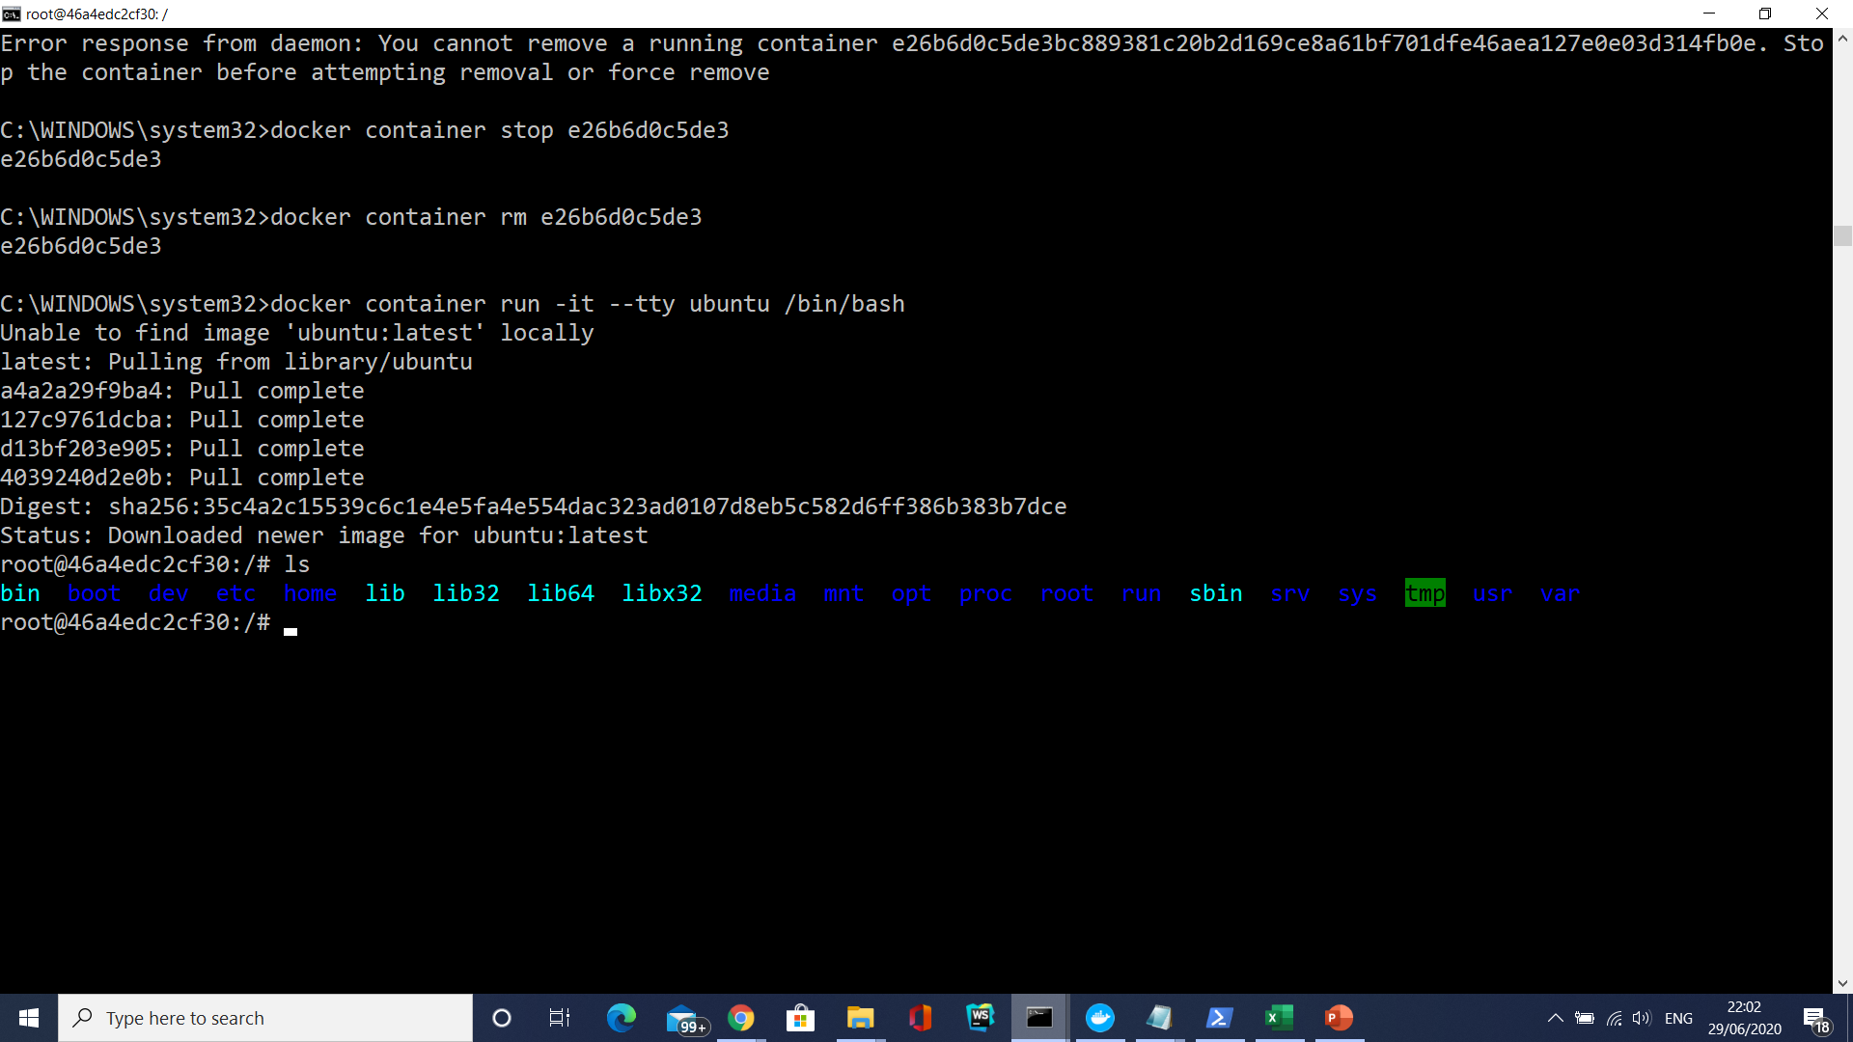

Slide 92
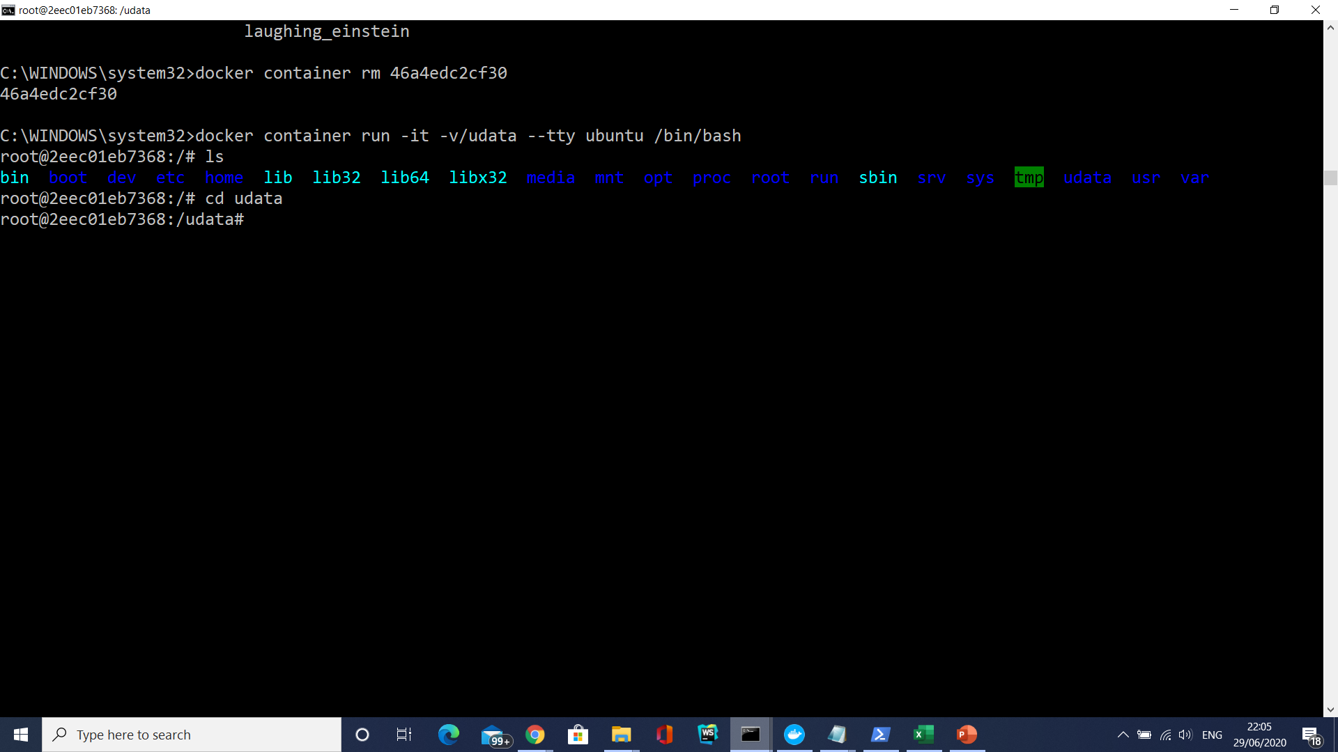

Slide 93
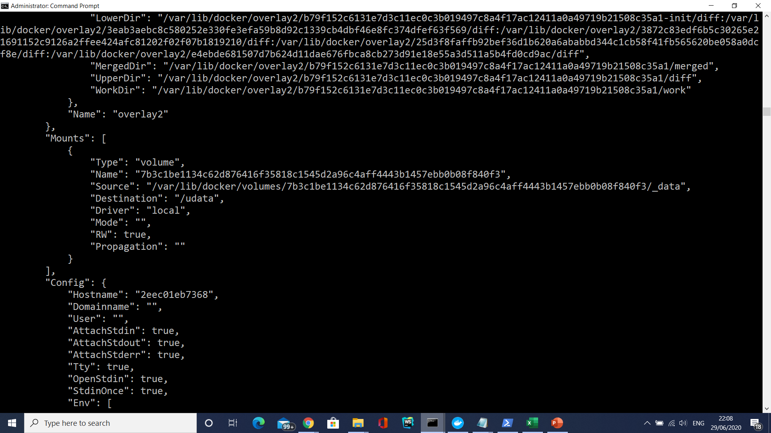

Slide 94
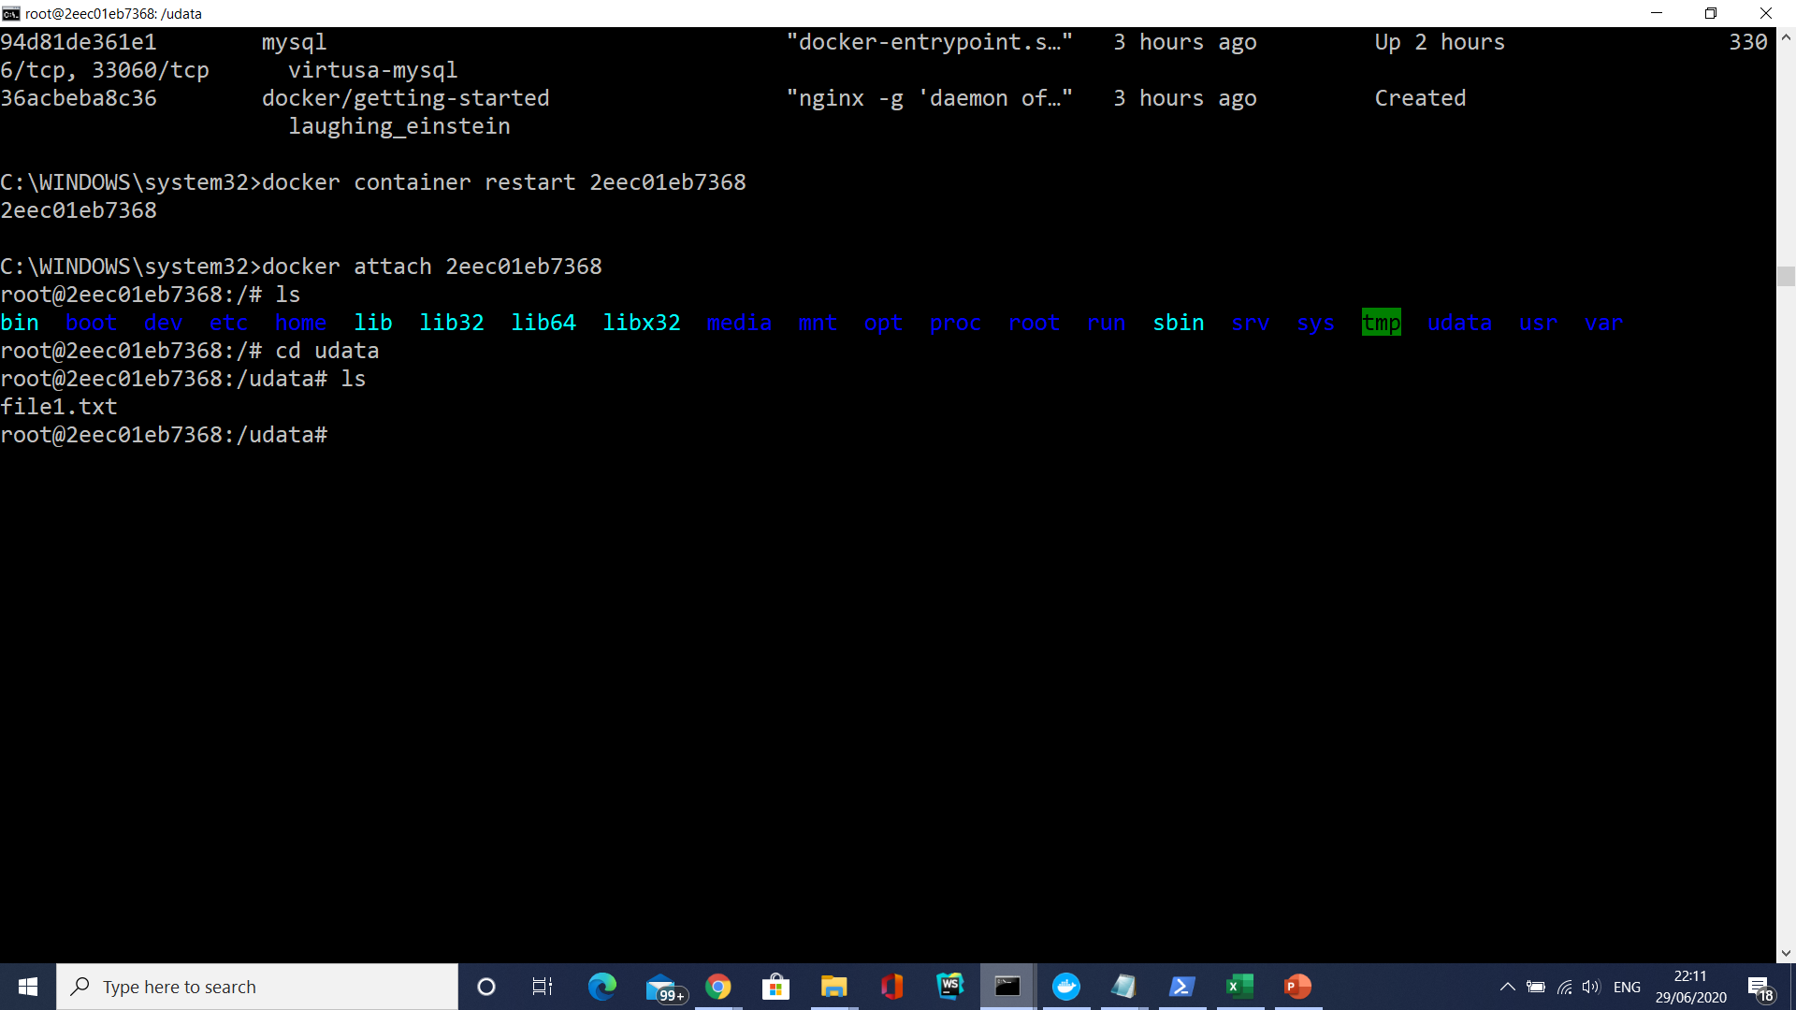

Slide 95
Manage Data in Docker
The sequence of steps are as follows:
We restarted the container (container1)
We attached to the running container (container1)
We did a ls and found that our volume /data is still there.
We did a cd into the /data volume and did a ls there. And our file is still present.

Slide 96
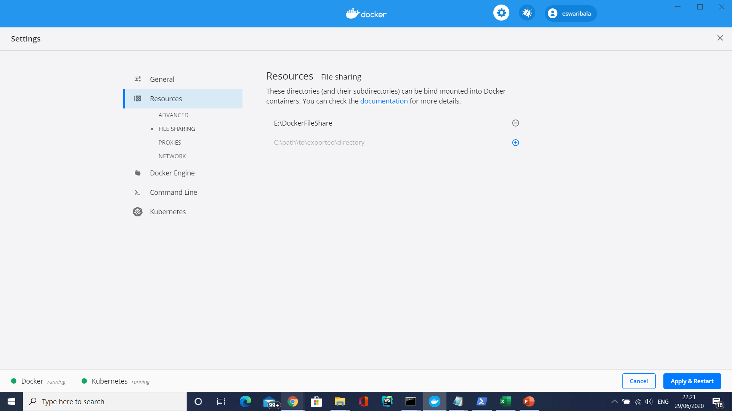
Mounting a Host Directory as a Data volume
docker container run -it -v e:/DockerFileShare/project/web01:/mnt/test ubuntu /bin/bash

Slide 97
Data volume containers
Creating a Data volume container is very useful if you want to share data between containers or you want to use the data from non-persistent containers.
The process is really two step:
You first create a Data volume container
Create another container and mount the volume from the container created in Step 1.

Slide 98
Data volume containers
Creating a Data volume container is very useful if you want to share data between containers or you want to use the data from non-persistent containers.
The process is really two step:
You first create a Data volume container
Create another container and mount the volume from the container created in Step 1.

Slide 99
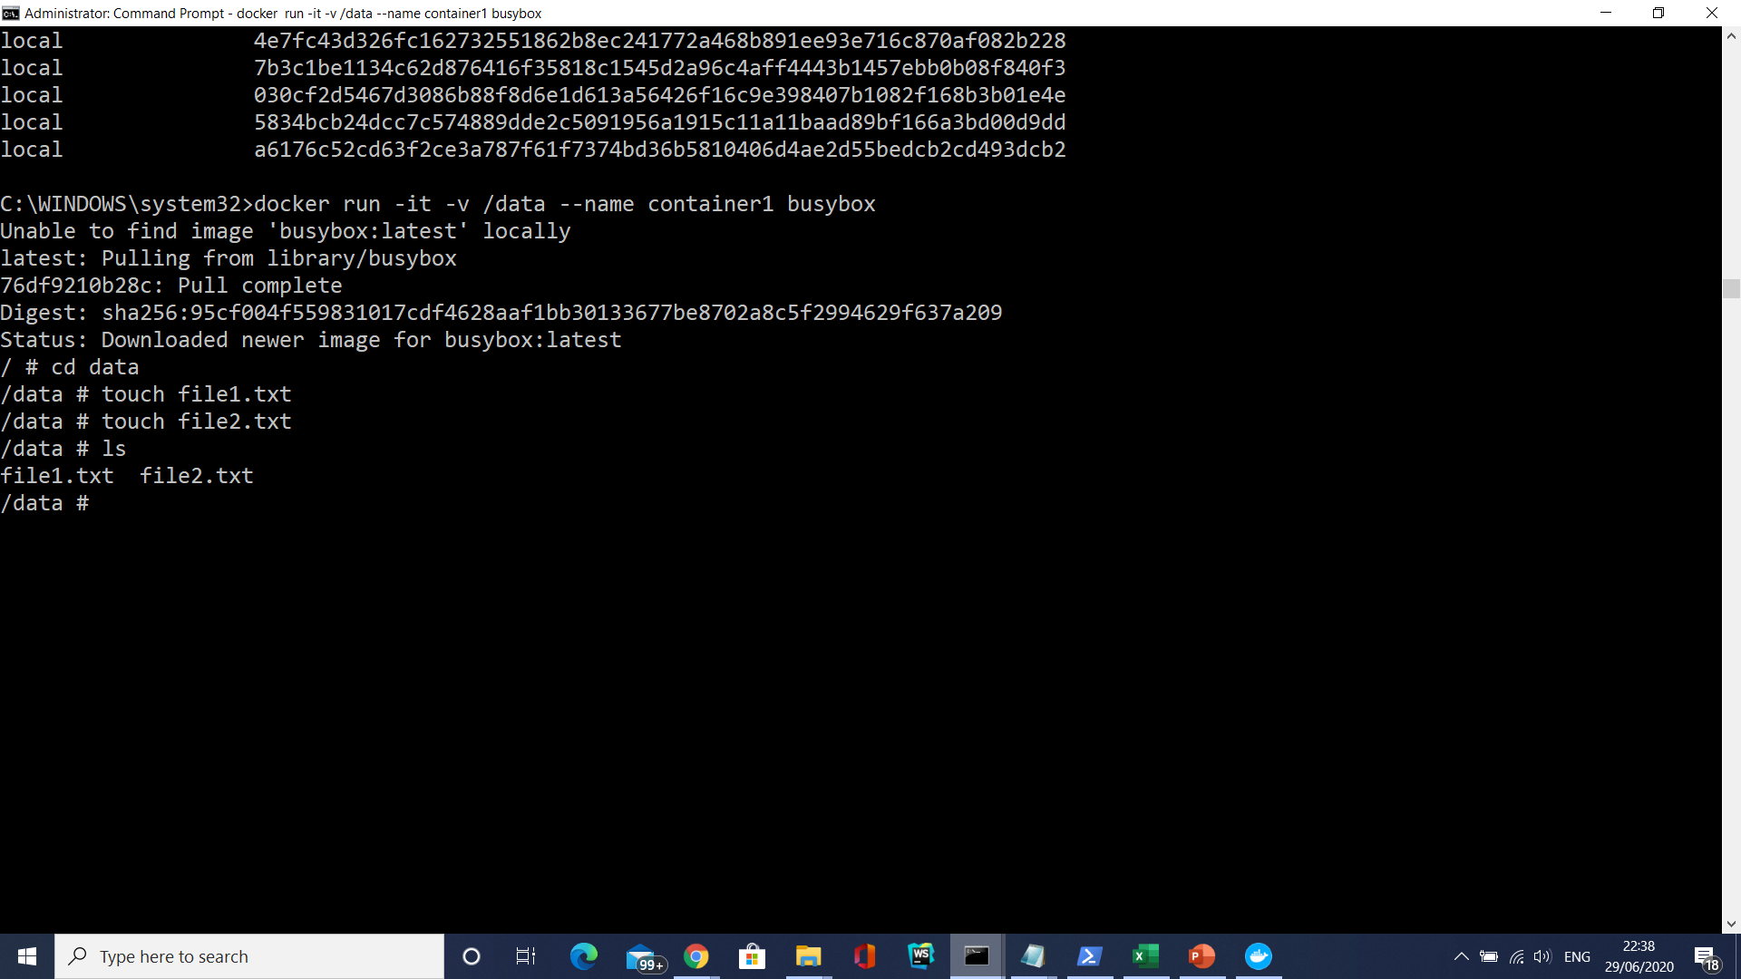
Data volume containers

Slide 100

Data volume containers

Slide 101
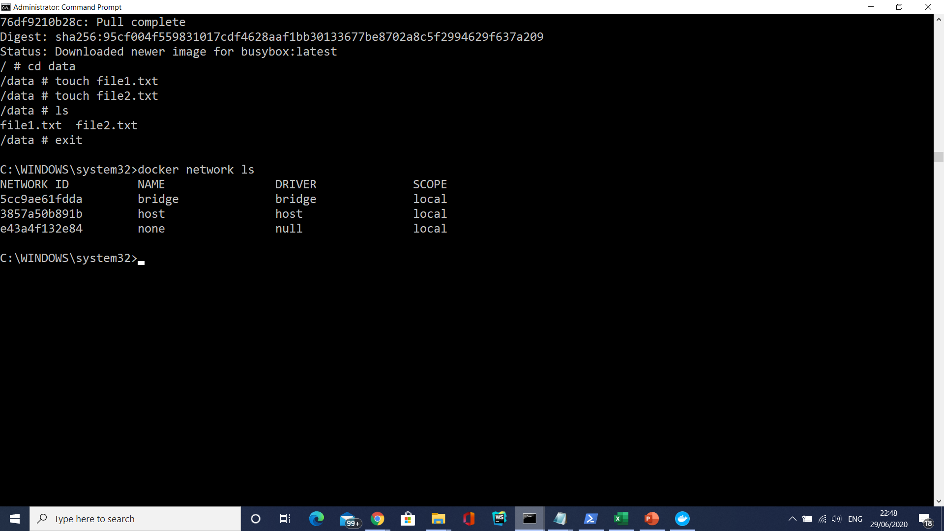
Docker network

Slide 102
Docker network
docker network inspect bridge
Docker automatically creates a subnet and gateway for the bridge network, and docker run automatically adds containers to it. I
If you have containers running on your network, docker network inspect displays networking information for your containers.

Slide 103
Docker network
Any containers on the same network may communicate with one another via IP addresses.
Docker does not support automatic service discovery on bridge.
You must connect containers with the --link option in your docker run command.

Slide 104
Docker network
The Docker bridge supports port mappings and docker run --link allowing communications between containers on the docker0 network.
However, these error-prone techniques require unnecessary complexity.
It’s better to define your own networks instead.

Slide 105
Docker network
None
This offers a container-specific network stack that lacks a network interface.
This container only has a local loopback interface (i.e., no external network interface).

Slide 106
Docker network
Host
This enables a container to attach to your host’s network (meaning the configuration inside the container matches the configuration outside the container).

Slide 107
Defining your own networks
You can create multiple networks with Docker and add containers to one or more networks.
Containers can communicate within networks but not across networks.
A container with attachments to multiple networks can connect with all of the containers on all of those networks.
This lets you build a “hub” of sorts to connect to multiple networks and separate concerns.

Slide 108
Defining your own networks
Bridge networks (similar to the default docker0 network) offer the easiest solution to creating your own Docker network.
While similar, you do not simply clone the default0 network, so you get some new features and lose some old ones.
Follow along below to create your own my_isolated_bridge_network and run your Postgres container my_mysql_db on that network:

Slide 109
Defining your own networks
docker network create --driver bridge my_isolated_bridge_network
docker network inspect my_isolated_bridge_network
docker network ls
docker run --net=my_isolated_bridge_network --name=my_psql_db postgres
docker run --network=my_isolated_bridge_network --name=my_app hello-world

Slide 110
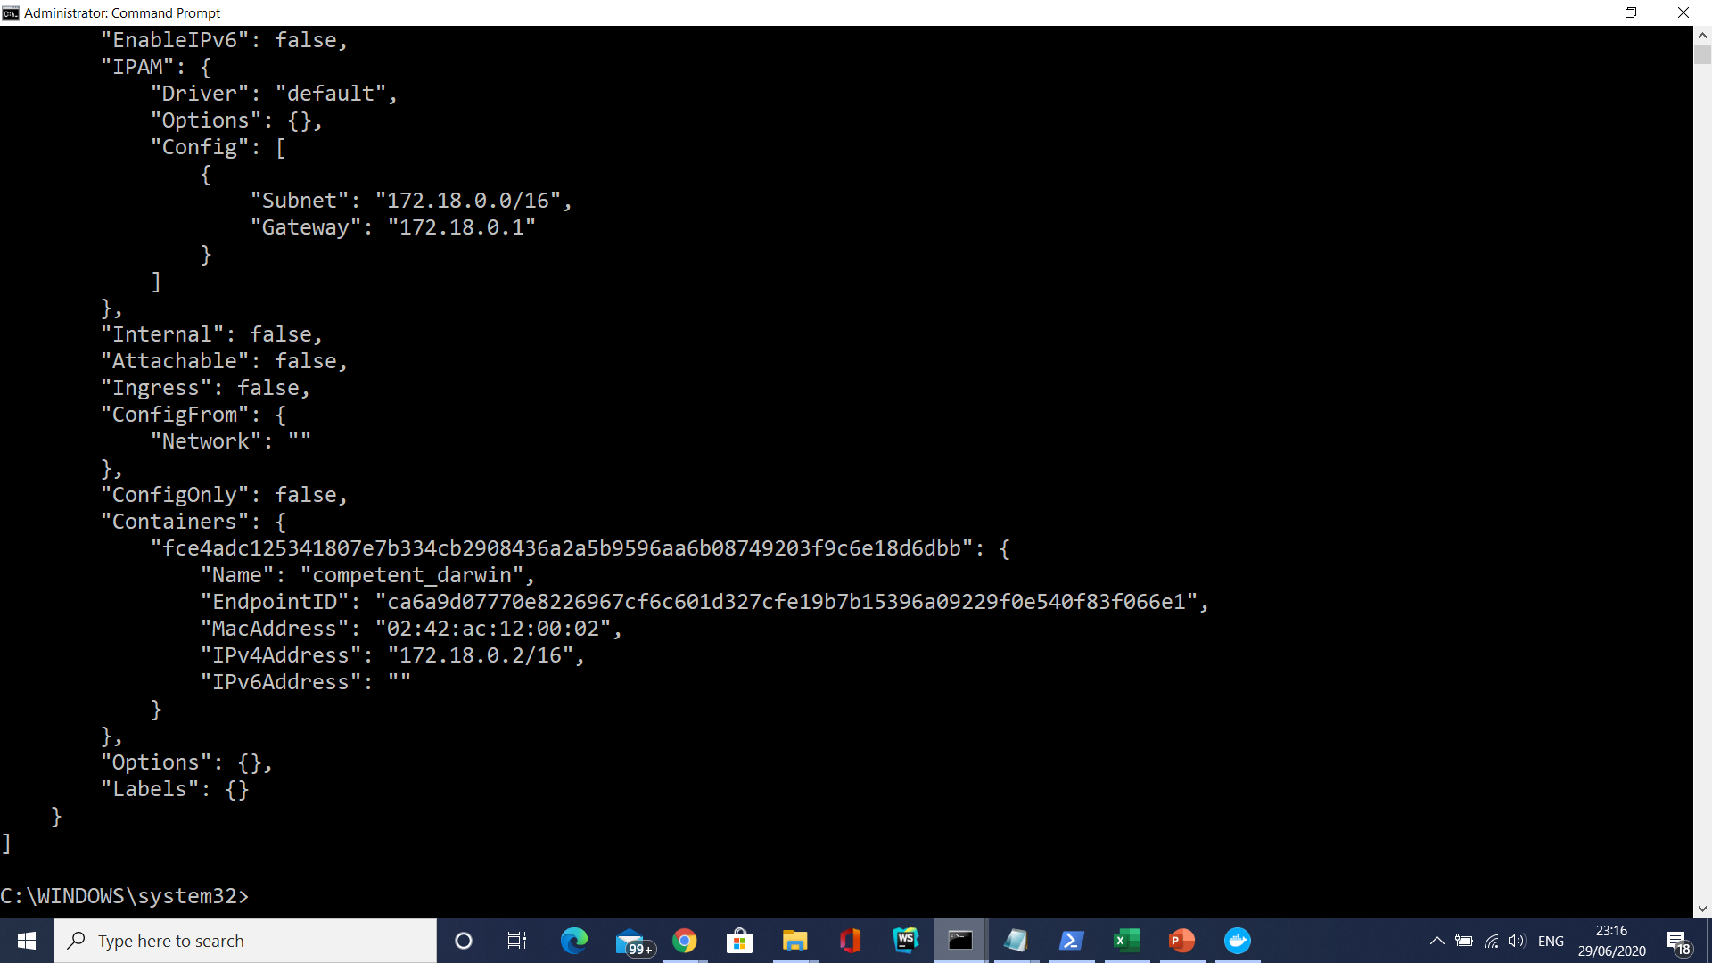
Defining your own networks

Slide 111
Creating an overlay network
If you want native multi-host networking, you need to create an overlay network.
These networks require a valid key-value store service, such as Consul, Etcd, or ZooKeeper.
You must install and configure your key-value store service before creating your network.
Your Docker hosts (you can use multiple hosts with overlay networks) must communicate with the service you choose.
Each host needs to run Docker.
You can provision the hosts with Docker Machine.

Slide 112
Creating an overlay network
Create the overlay network in a similar manner to the bridge network (network name my_multi_host_network):
docker network create --driver overlay my_multi_host_network
Launch containers on each host; make sure you specify the network name:
docker run -itd -net=my_multi_host_network my_python_app

Slide 113
Getting Started with Artifactory as a Docker Registry
Login to your repository use the following command with your Artifactory Cloud credentials.
docker login ${server-name}-{repo-name}.jfrog.io
Pull an image using the following command.
docker pull ${server-name}-{repo-name}.jfrog.io/<image name>
Push an image by first tagging it and then using the push command.
docker tag <image name> ${server-name}-{repo-name}.jfrog.io/<image name>
docker push ${server-name}-{repo-name}.jfrog.io/<image name>

Slide 114
Getting Started with Artifactory as a Docker Registry
In this example, the Artifactory Cloud server is named acme.
Start by creating a virtual Docker repository called dockerv2-virtual.
Pull the hello-world image
docker pull hello-world
Login to repository dockerv2-virtual
docker login acme-dockerv2-virtual.jfrog.io
Tag the hello-world image
docker tag hello-world acme-dockerv2-virtual.jfrog.io/hello-world
Push the tagged hello-world image to dockerv2-virtual
docker push acme-dockerv2-virtual.jfrog.io/hello-world

Slide 115
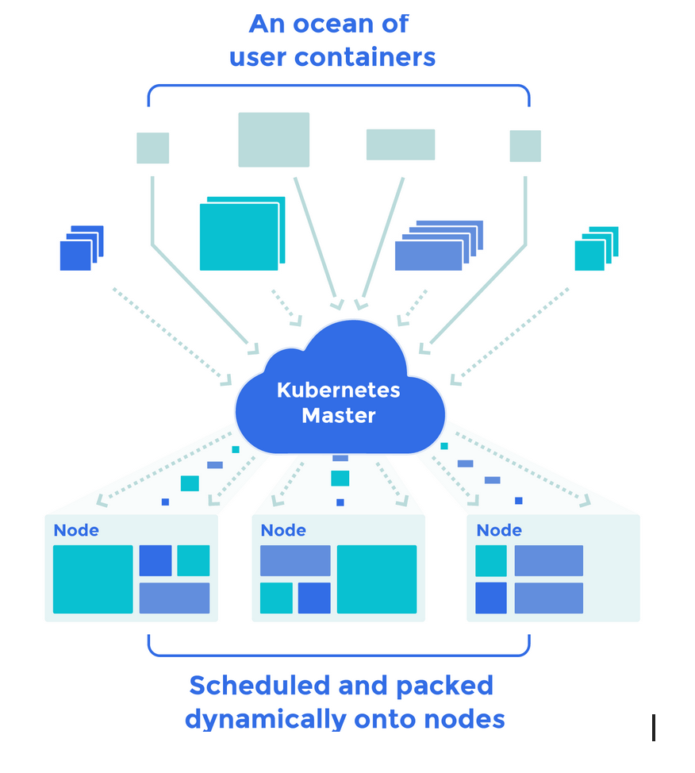

Slide 116
Docker Swarm
Docker Swarm is Docker’s native feature to support clustering of Docker machines.
This enables multiple machines running Docker Engine to participate in a cluster, called Swarm.
The Docker engines contributing to a Swarm are said to be running in Swarm mode.
Machines enter into the Swarm mode by either initializing a new swarm or by joining an existing swarm.
To the end user the swarm would seem like a single machine.
A Docker engine participating in a swarm is called a node

Slide 117
Docker Swarm
. A node can either be a manager node or a worker node.
The manager node performs cluster management and orchestration while the worker nodes perform tasks allocated by the manager.
A manager node itself, unless configured otherwise, is also be a worker node.
The central entity in the Docker Swarm infrastructure is called a service.
A Docker swarm executes services. The user submits a service to the manager node to deploy and execute.
A service is made up of many tasks. A task is the most basic work unit in a Swarm.
A task is allocated to each worker node b the manager node.

Slide 118
Docker Swarm
The Docker ecosystem consists of tools from development to production deployment frameworks.
In that list, docker swarm fits into cluster management.
A mix of docker-compose, swarm, overlay network and a good service discovery tool such as etcd or consul can be used for managing a cluster of Docker containers.
Docker swarm is still maturing in terms of functionalities when compared to other open-source container cluster management tools.
Considering the vast docker contributors, it won’t be so long for docker swarm to have all the best functionalities other tools possess.
Docker has documented a good production plan for using docker swarm in production.

Slide 119
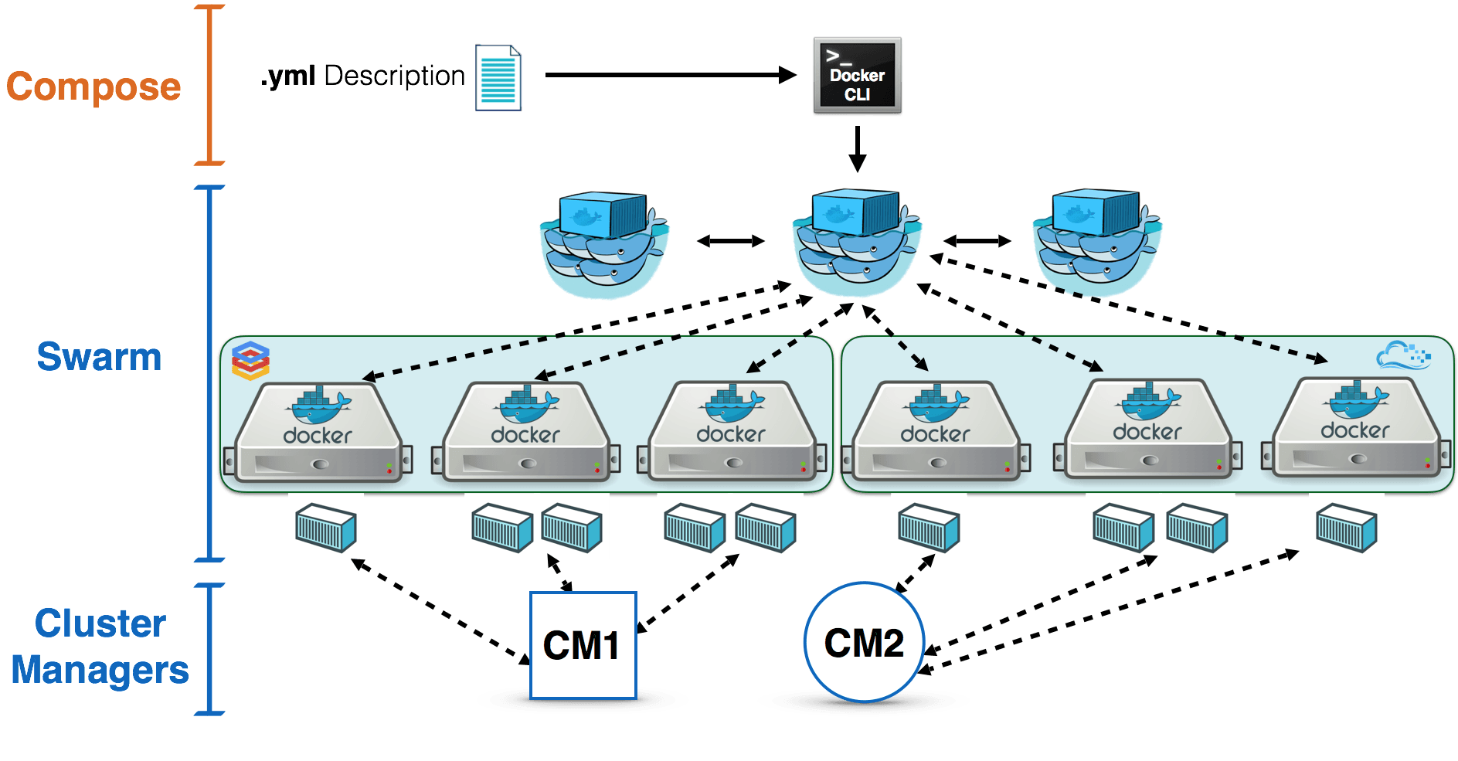

Slide 120
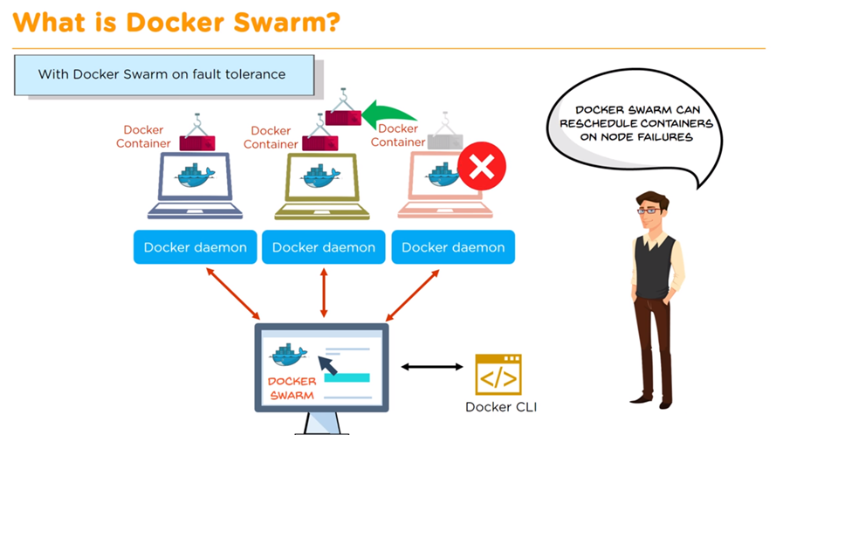

Slide 121
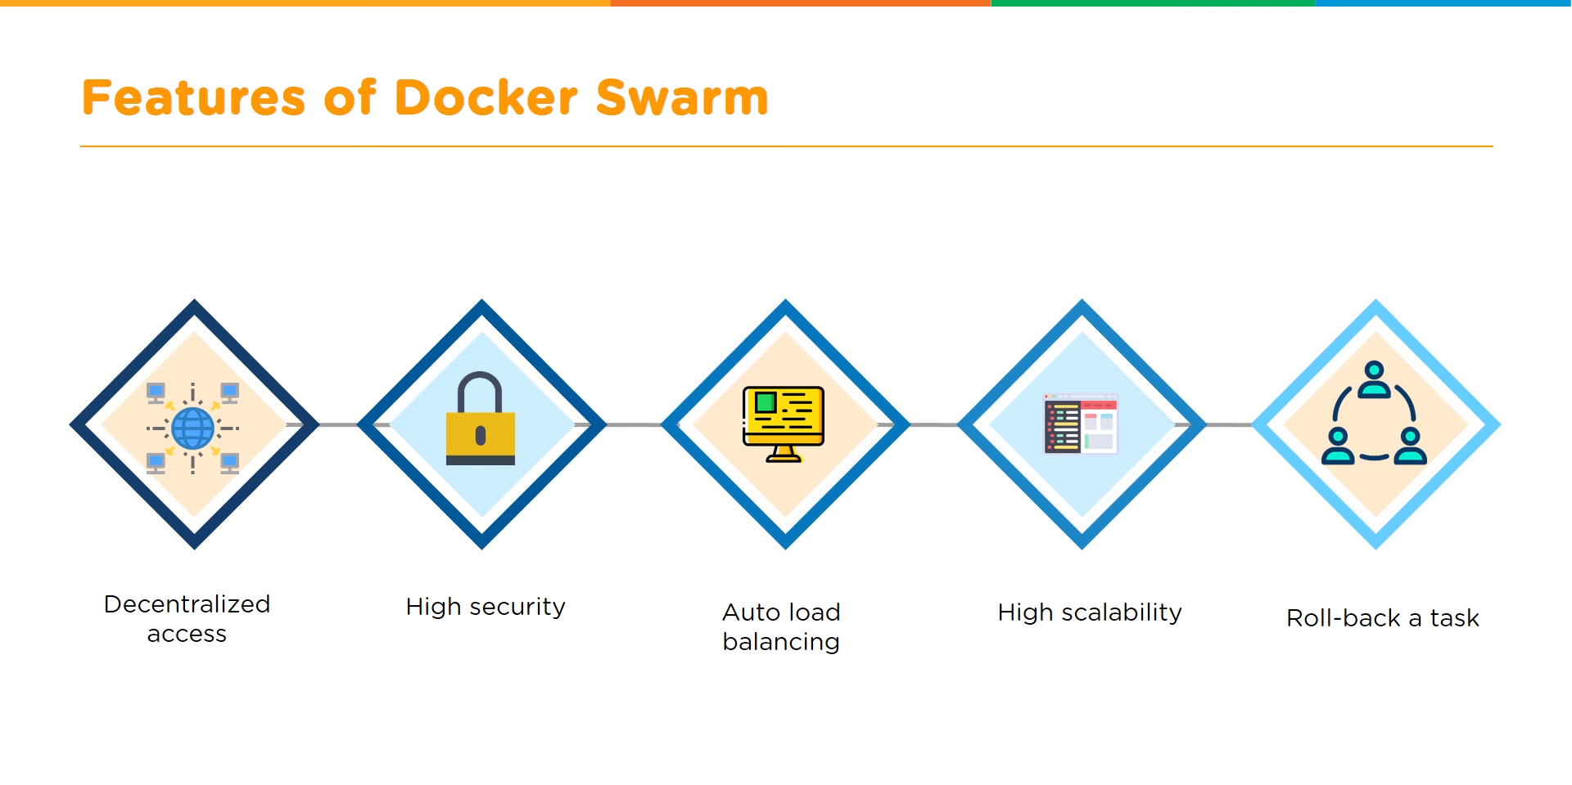

Slide 122
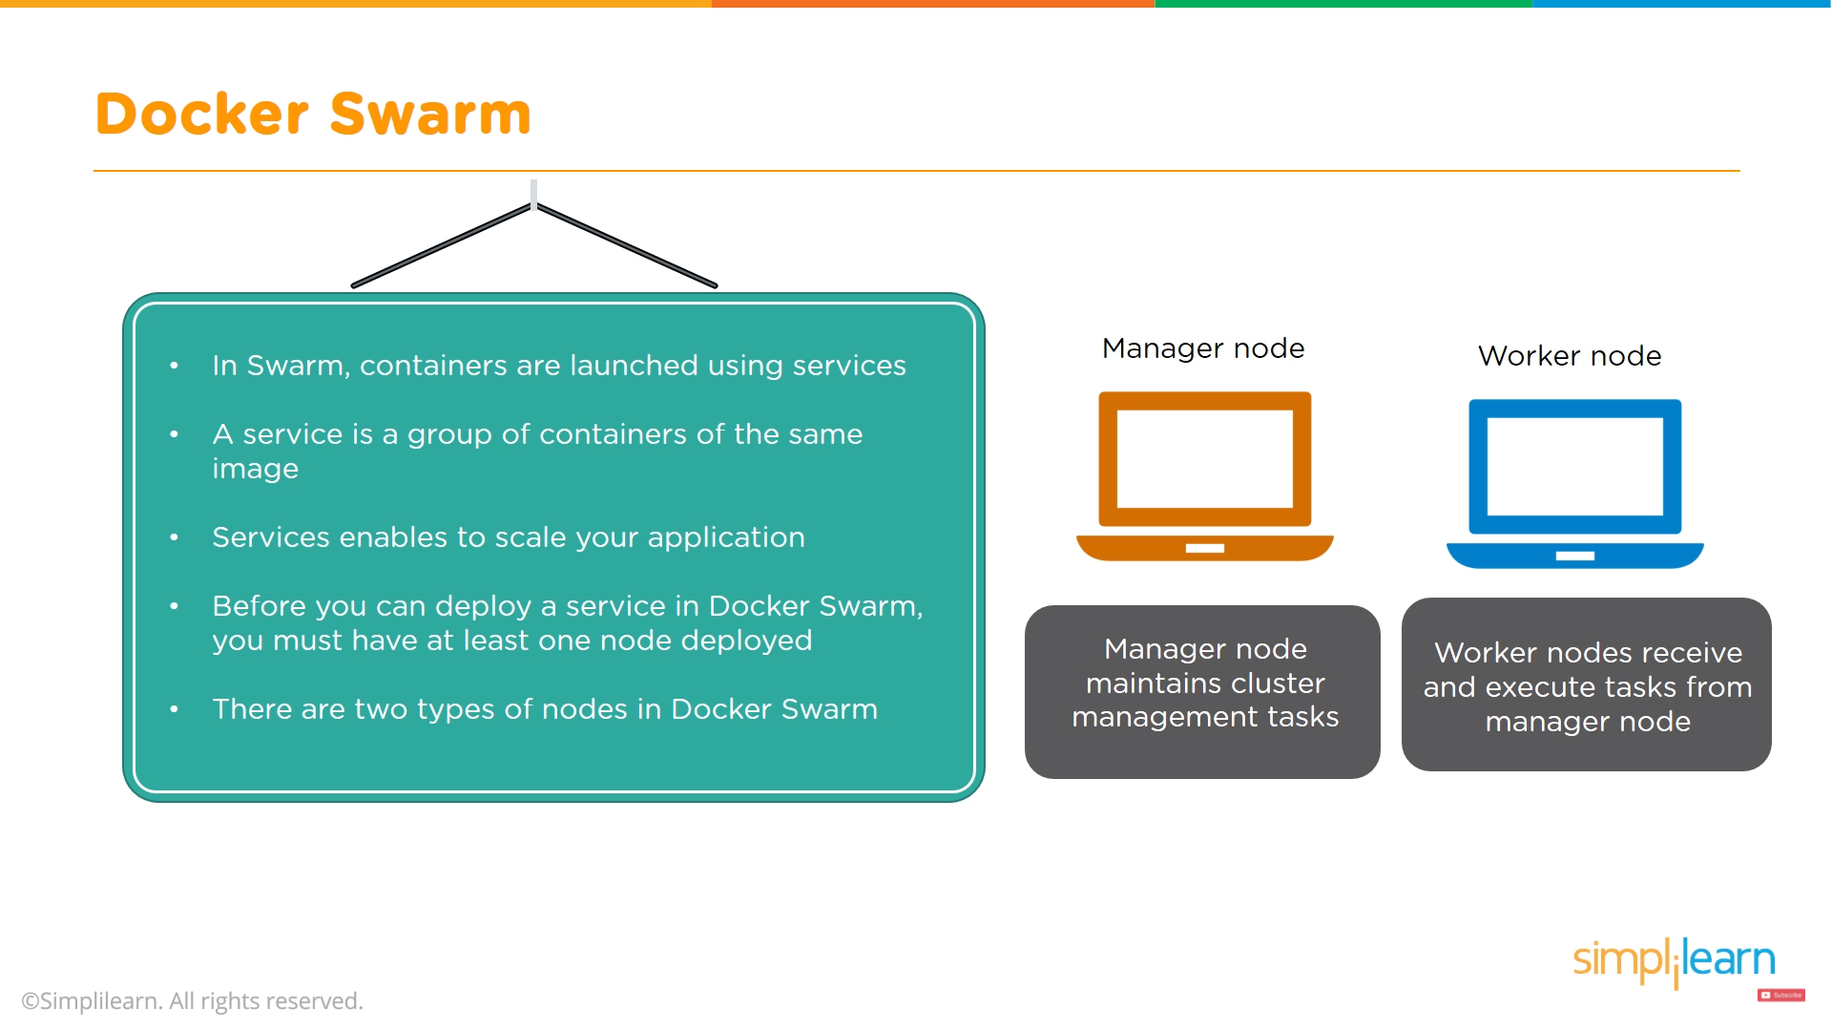

Slide 123
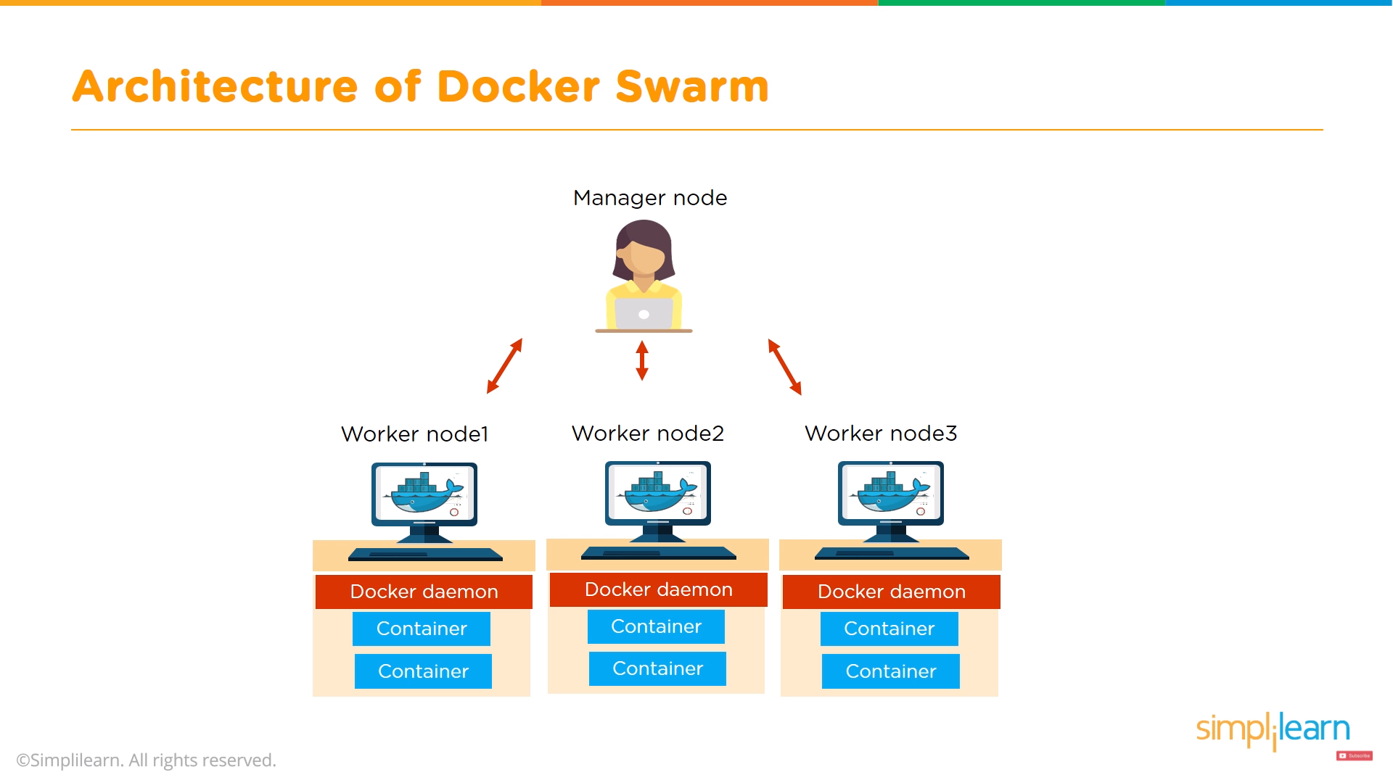

Slide 124
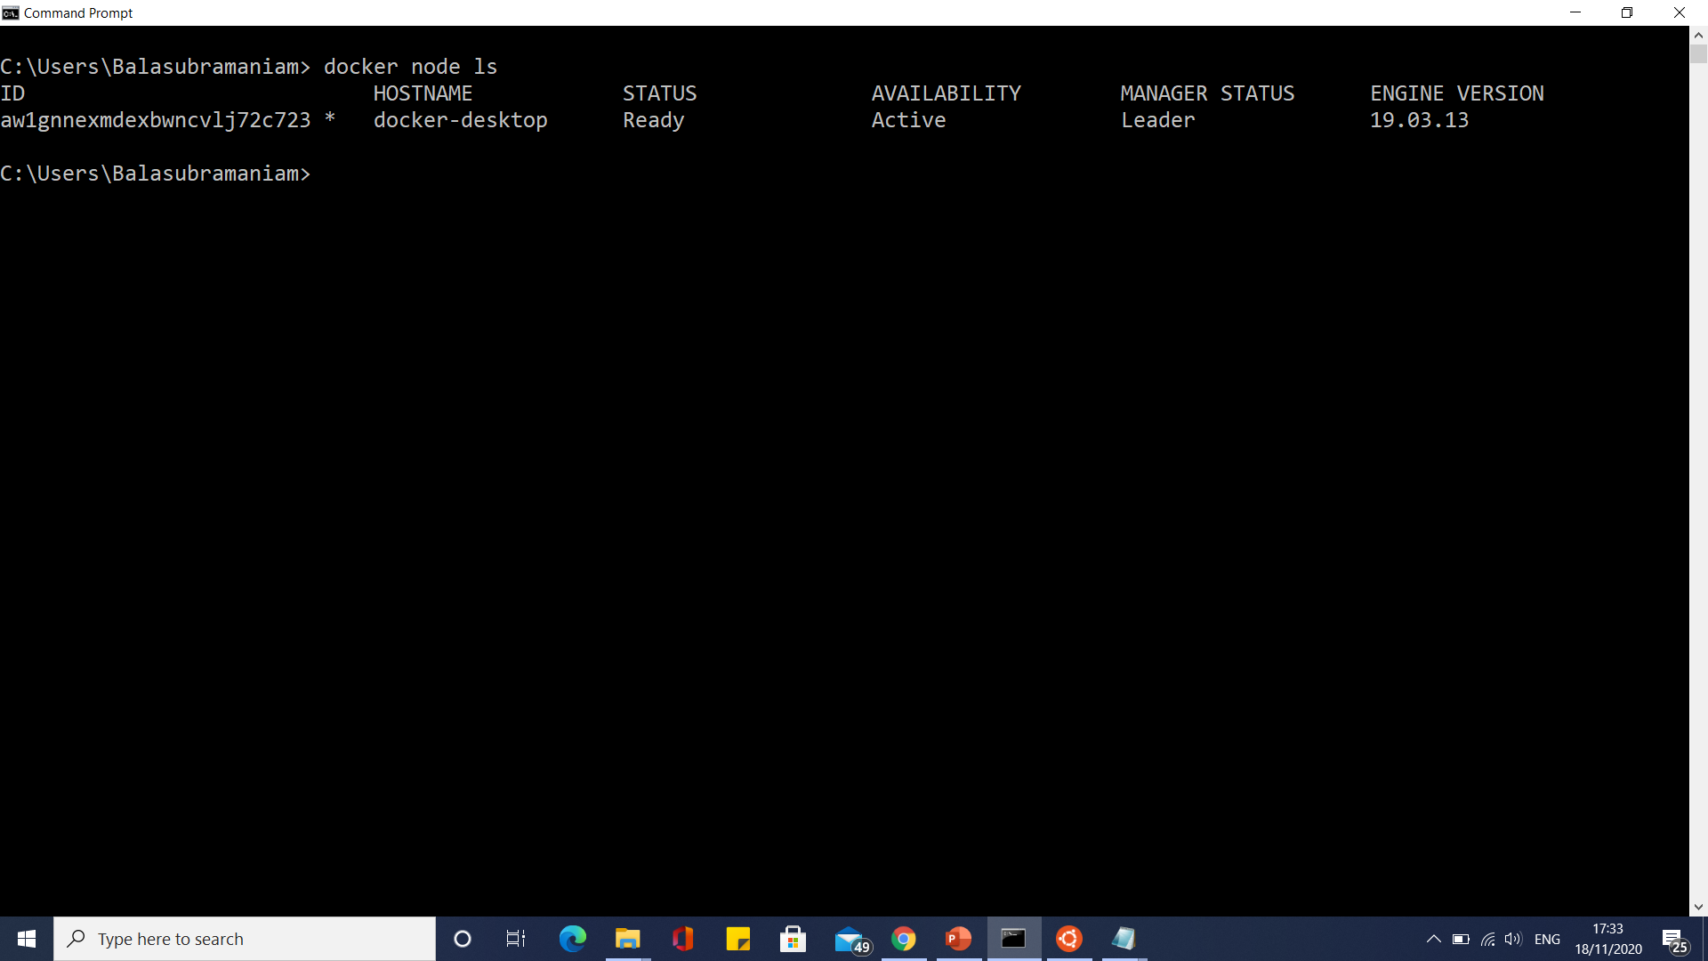
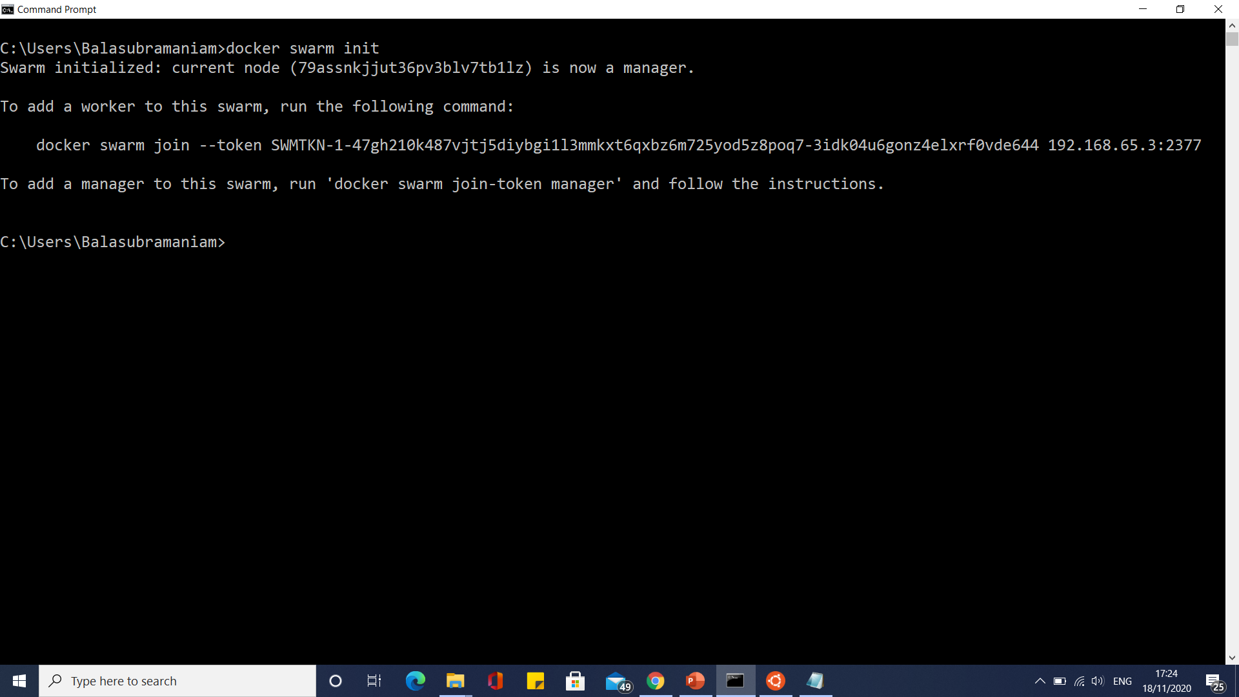
Docker Swarm Steps

Slide 125
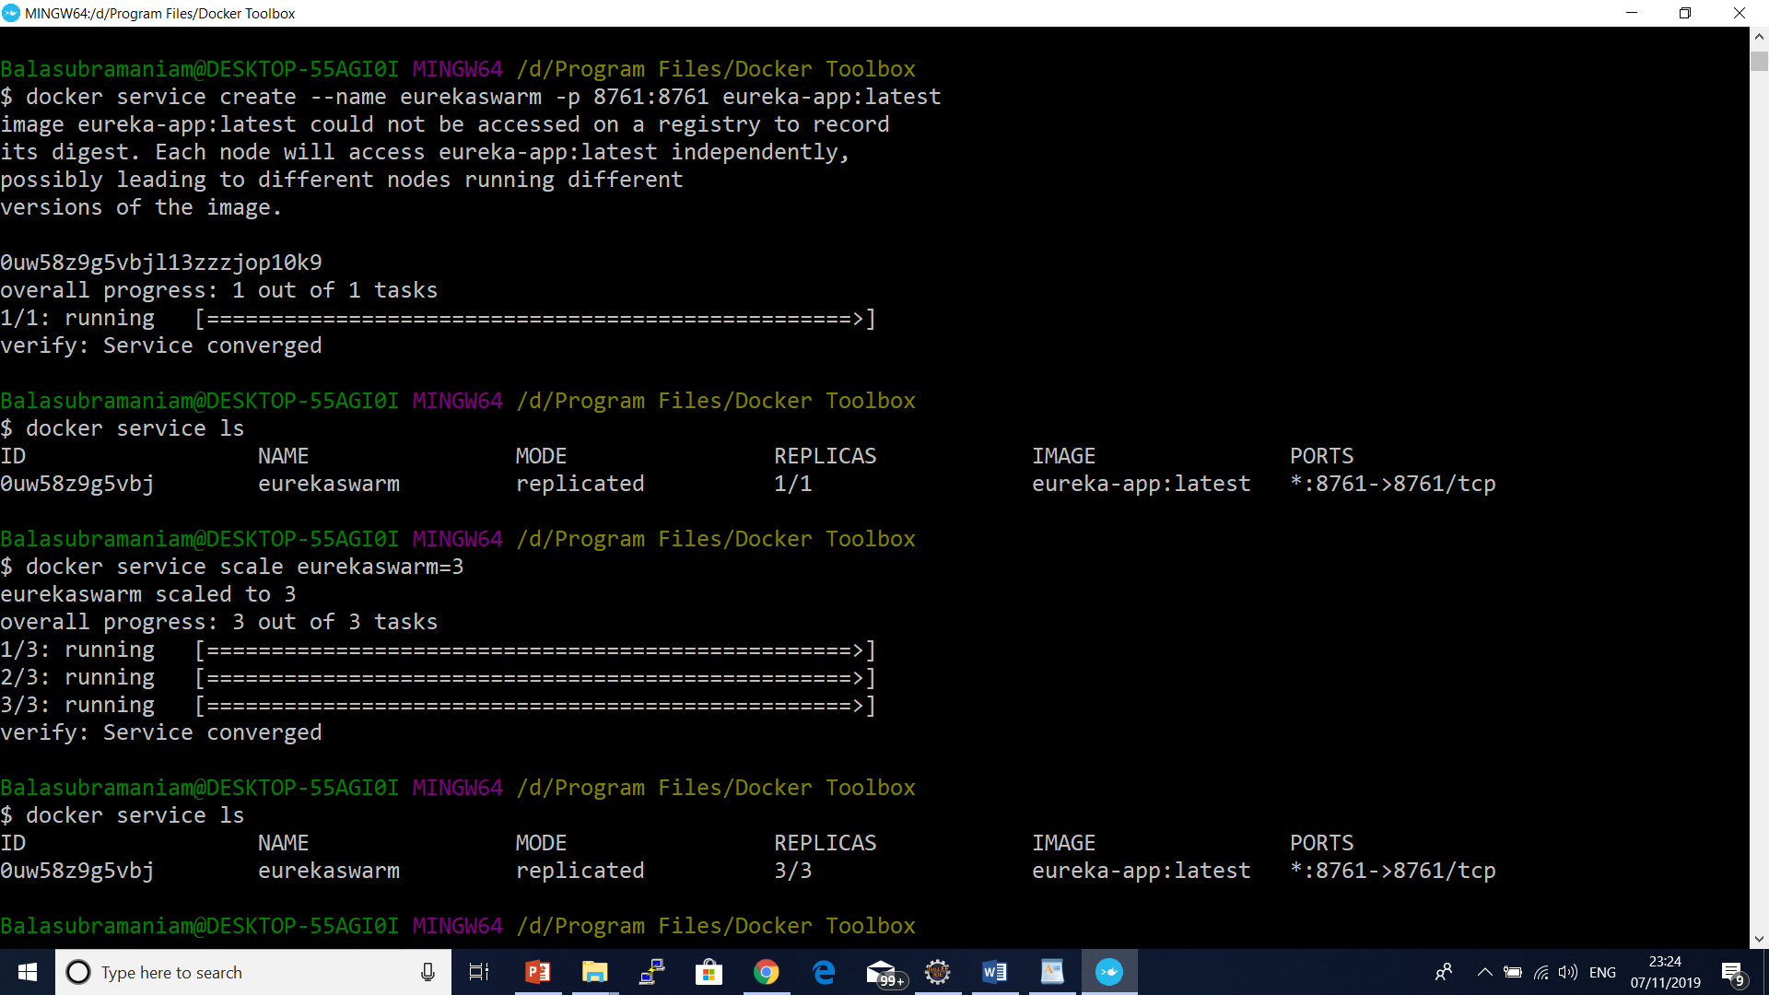

Slide 126
What is Kubernetes?
Kubernetes is a portable, extensible, open-source platform for managing containerized workloads and services, that facilitates both declarative configuration and automation.
It has a large, rapidly growing ecosystem. Kubernetes services, support, and tools are widely available.
The name Kubernetes originates from Greek, meaning helmsman or pilot.
Google open-sourced the Kubernetes project in 2014.
Kubernetes combines over 15 years of Google's experience running production workloads at scale with best-of-breed ideas and practices from the community.

Slide 127
What Is Kubernetes? An Introduction To Container Orchestration Tool
What Is Kubernetes?
Kubernetes is an open-source container management (orchestration) tool. It’s container management responsibilities include container deployment, scaling & descaling of containers & container load balancing.
Download from
https://github.com/kubernetes/minikube
Under curl - windows
https://kubernetes.io/docs/tasks/tools/install-kubectl/#install-kubectl

Slide 128
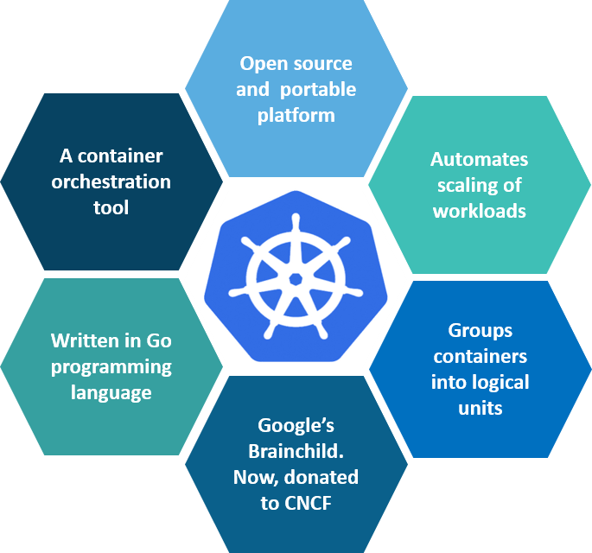
What is Kubernetes

Slide 129
What Is Kubernetes? An Introduction To Container Orchestration Tool
Why Use Kubernetes?
Companies out there maybe using Docker or Rocket or maybe simply Linux containers for containerizing their applications. But, whatever it is, they use it on a massive scale. They don’t stop at using 1 or 2 containers in Prod. But rather, 10’s or 100’s of containers for load balancing the traffic and ensuring high availability.
.

Slide 130
Why use Kubernetes?
Kubernetes can run on-premises bare metal, OpenStack, public clouds Google, Azure, AWS, etc.
Helps you to avoid vendor lock issues as it can use any vendor-specific APIs or services except where Kubernetes provides an abstraction, e.g., load balancer and storage.
Containerization using kubernetes allows package software to serve these goals. It will enable applications that need to be released and updated without any downtime.
Kubernetes allows you to assure those containerized applications run where and when you want and helps you to find resources and tools which you want to work.

Slide 131
What task are performed by Kubernetes?
Kubernetes is the Linux kernel which is used for distributed systems.
It helps you to be abstract the underlying hardware of the nodes(servers) and offers a consistent interface for applications that consume the shared pool of resources.

Slide 132
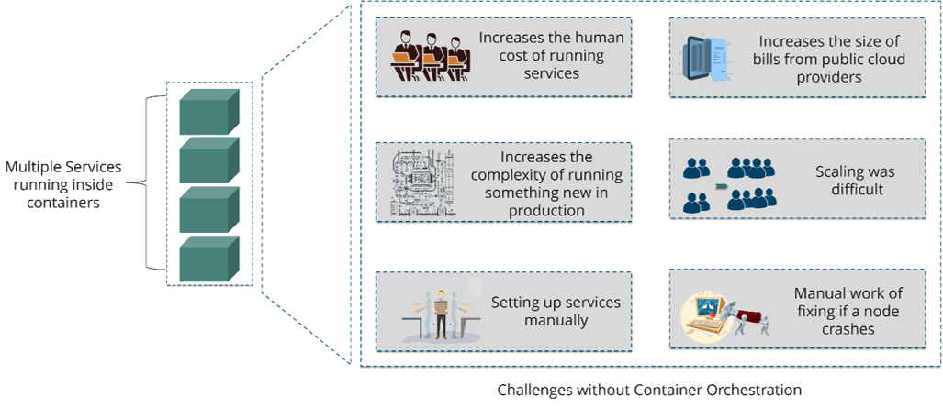
What is the need for Container Orchestration?

Slide 133
Kubernetes vs Docker Swarm
Features | Kubernetes | Docker Swarm
Installation & Cluster Config | Setup is very complicated, but once installed cluster is robust. | Installation is very simple, but the cluster is not robust.
GUI | GUI is the Kubernetes Dashboard. | There is no GUI.
Scalability | Highly scalable and scales fast. | Highly scalable and scales 5x faster than Kubernetes.
Auto-scaling | Kubernetes can do auto-scaling. | Docker swarm cannot do auto-scaling.
Load Balancing | Manual intervention needed for load balancing traffic between different containers and pods. | Docker swarm does auto load balancing of traffic between containers in the cluster.
Rolling Updates & Rollbacks | Can deploy rolling updates and does automatic rollbacks. | Can deploy rolling updates, but not automatic rollback.
DATA Volumes | Can share storage volumes only with the other containers in the same pod. | Can share storage volumes with any other container.
Logging & Monitoring | In-built tools for logging and monitoring. | 3rd party tools like ELK stack should be used for logging and monitoring.

Slide 134
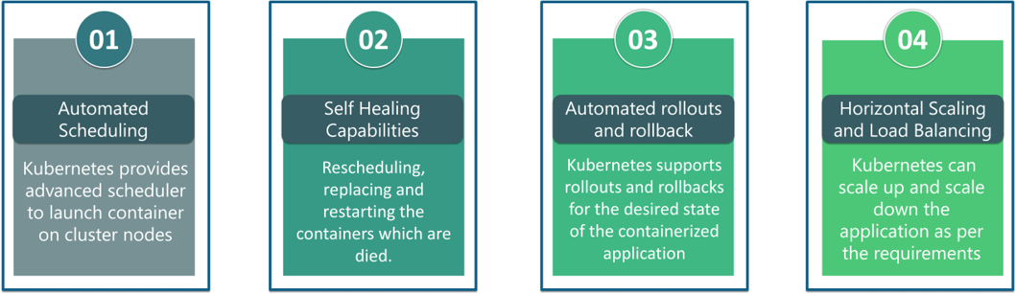
What are the features of Kubernetes?

Slide 135
Features of Kubernetes
Automated Scheduling
Self-Healing Capabilities
Automated rollouts & rollback
Horizontal Scaling & Load Balancing
Offers environment consistency for development, testing, and production
Infrastructure is loosely coupled to each component can act as a separate unit
Provides a higher density of resource utilization
Offers enterprise-ready features
Application-centric management
Auto-scalable infrastructure
You can create predictable infrastructure

Slide 136
Kubernetes Basics
Cluster:
It is a collection of hosts(servers) that helps you to aggregate their available resources. That includes ram, CPU, ram, disk, and their devices into a usable pool.
Master:
The master is a collection of components which make up the control panel of Kubernetes. These components are used for all cluster decisions. It includes both scheduling and responding to cluster events.

Slide 137
Kubernetes Basics
Node:
It is a single host which is capable of running on a physical or virtual machine. A node should run both kube-proxy, minikube, and kubelet which are considered as a part of the cluster.
Namespace:
It is a logical cluster or environment. It is a widely used method which is used for scoping access or dividing a cluster.

Slide 138
Kubernetes Architecture and Components
Kubernetes has a decentralized architecture that does not handle tasks sequentially.
It functions based on a declarative model and implements the concept of a ‘desired state.’

Slide 139
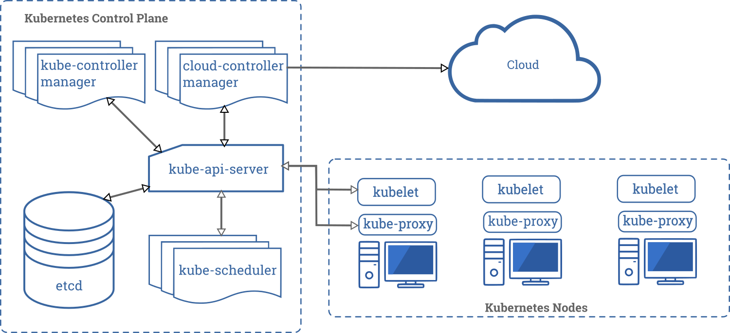

Slide 140
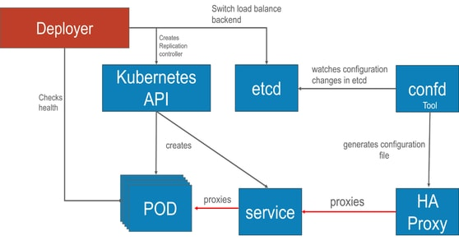
Kubernetes architecture

Slide 141
Kubernetes Architecture and Components
These steps illustrate the basic Kubernetes process:
An administrator creates and places the desired state of an application into a manifest file.
The file is provided to the Kubernetes API Server using a CLI or UI.
Kubernetes’ default command-line tool is called kubectl.
Kubernetes stores the file (an application’s desired state) in a database called the Key-Value Store (etcd).
Kubernetes then implements the desired state on all the relevant applications within the cluster.
Kubernetes continuously monitors the elements of the cluster to make sure the current state of the application does not vary from the desired state.

Slide 142
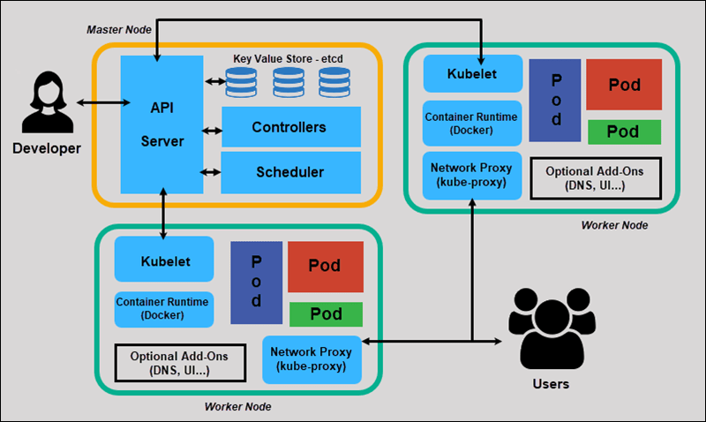
Kubernetes Architecture and Components

Slide 143
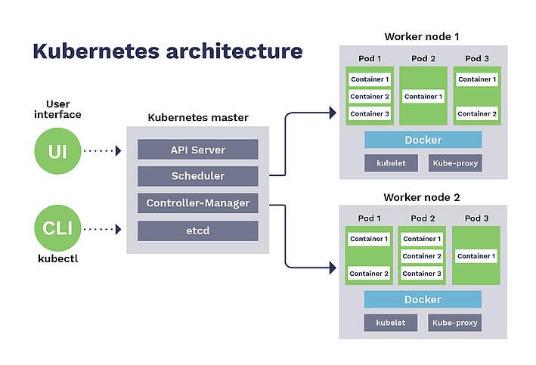
Kubernetes Architecture and Components

Slide 144
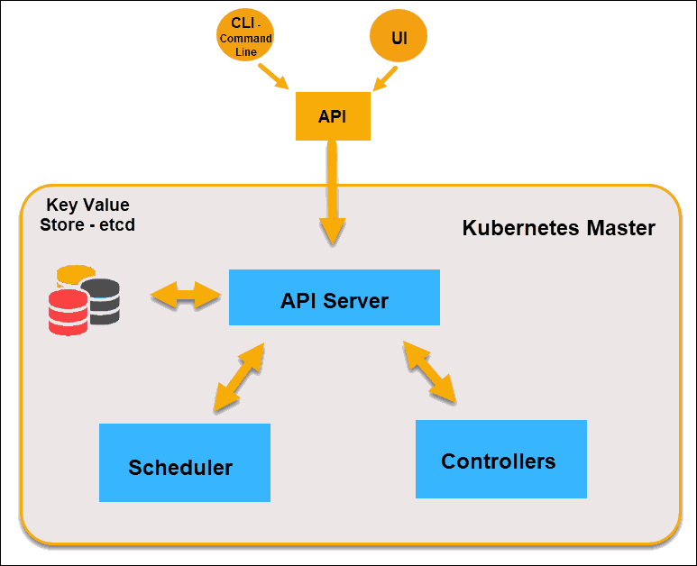
What is Master Node in Kubernetes Architecture?

Slide 145
API Server
The API Server is the front-end of the control plane and the only component in the control plane that we interact with directly.
Internal system components, as well as external user components, all communicate via the same API.

Slide 146
Key-Value Store (etcd)
The Key-Value Store, also called etcd, is a database Kubernetes uses to back-up all cluster data.
It stores the entire configuration and state of the cluster.
The Master node queries etcd to retrieve parameters for the state of the nodes, pods, and containers.

Slide 147
Controller
The role of the Controller is to obtain the desired state from the API Server.
It checks the current state of the nodes it is tasked to control, and determines if there are any differences, and resolves them, if any.

Slide 148
Scheduler
A Scheduler watches for new requests coming from the API Server and assigns them to healthy nodes.
It ranks the quality of the nodes and deploys pods to the best-suited node.
If there are no suitable nodes, the pods are put in a pending state until such a node appears.

Slide 149
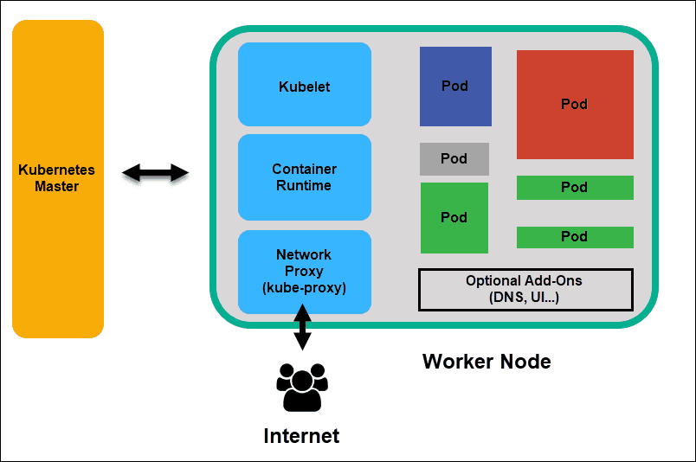
What is Worker Node in Kubernetes Architecture

Slide 150
Kubelet
The kubelet runs on every node in the cluster.
It is the principal Kubernetes agent.
By installing kubelet, the node’s CPU, RAM, and storage become part of the broader cluster.
It watches for tasks sent from the API Server, executes the task, and reports back to the Master.
It also monitors pods and reports back to the control panel if a pod is not fully functional.
Based on that information, the Master can then decide how to allocate tasks and resources to reach the desired state.

Slide 151
Container Runtime
The container runtime pulls images from a container image registry and starts and stops containers.
A 3rd party software or plugin, such as Docker, usually performs this function.

Slide 152
Kube-proxy
The kube-proxy makes sure that each node gets its IP address, implements local iptables and rules to handle routing and traffic load-balancing.

Slide 153
Pod
A pod is the smallest element of scheduling in Kubernetes. Without it, a container cannot be part of a cluster. If you need to scale your app, you can only do so by adding or removing pods.
The pod serves as a ‘wrapper’ for a single container with the application code. Based on the availability of resources, the Master schedules the pod on a specific node and coordinates with the container runtime to launch the container

Slide 154
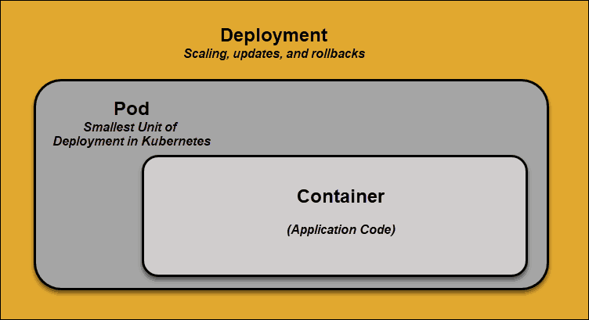
Pod

Slide 155
Pod
In instances where pods unexpectedly fail to perform their tasks, Kubernetes does not attempt to fix them.
Instead, it creates and starts a new pod in its place.
This new pod is a replica, except for the DNS and IP address.
This feature has had a profound impact on how developers design applications.
Due to the flexible nature of Kubernetes architecture, applications no longer need to be tied to a particular instance of a pod.
Instead, applications need to be designed so that an entirely new pod, created anywhere within the cluster, can seamlessly take its place. To assist with this process, Kubernetes uses services

Slide 156
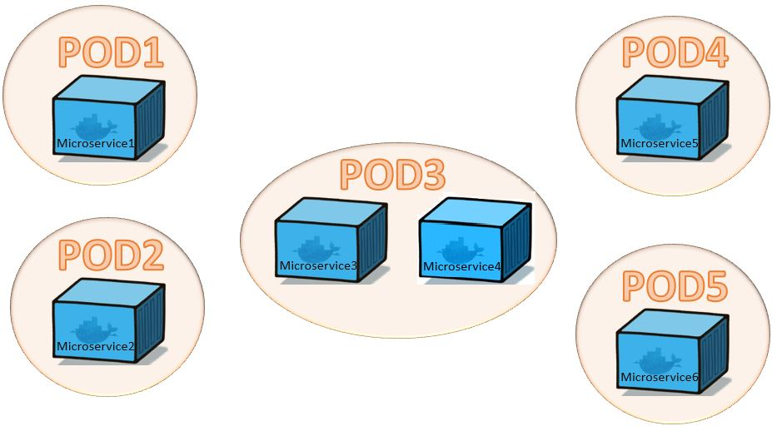

Slide 157
Single Pod with multiple containers
apiVersion: v1
kind: Pod
metadata:
name: mc1
spec:
volumes:
- name: html
emptyDir: {}
containers:
- name: 1st
image: nginx

Slide 158
Single Pod with multiple containers
volumeMounts:
- name: html
mountPath: /usr/share/nginx/html
- name: 2nd
image: debian
volumeMounts:
- name: html
mountPath: /html
command: ["/bin/sh", "-c"]
args:
- while true; do
date >> /html/index.html;
sleep 1;
done

Slide 159
States of a Pod
Through its lifecycle, a Pod can attain following states:
Pending: The pod is accepted by the Kubernetes system but its container(s) is/are not created yet.
Running: The pod is scheduled on a node and all its containers are created and at-least one container is in Running state.
Succeeded: All container(s) in the Pod have exited with status 0 and will not be restarted.
Failed: All container(s) of the Pod have exited and at least one container has returned a non-zero status.
CrashLoopBackoff: The container fails to start and is tried again and again.

Slide 160
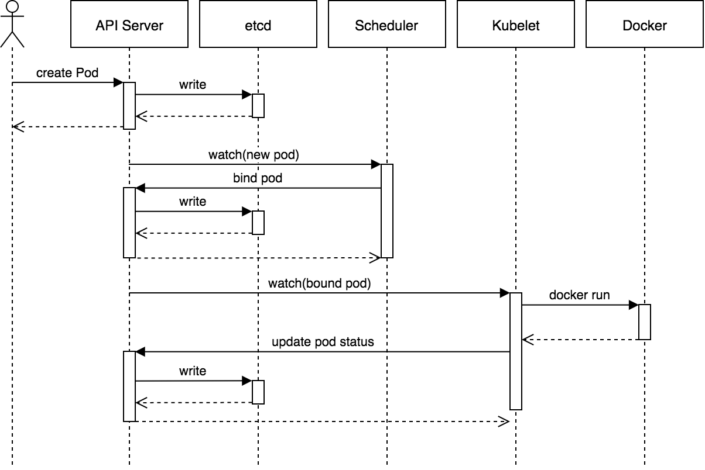
Birth of a Pod

Slide 161
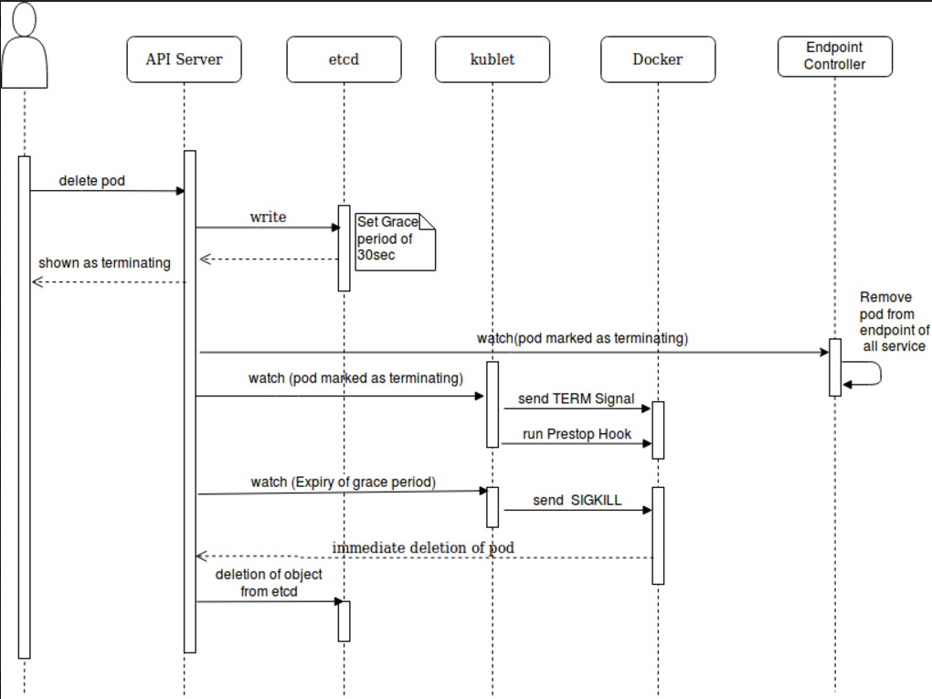
Pod Termination

Slide 162
Kubernetes Services
Pods are not constant. One of the best features Kubernetes offers is that non-functioning pods get replaced by new ones automatically.
However, these new pods have a different set of IPs. It can lead to processing issues, and IP churn as the IPs no longer match. If left unattended, this property would make pods highly unreliable.
Services are introduced to provide reliable networking by bringing stable IP addresses and DNS names to the unstable world of pods.
By controlling traffic coming and going to the pod, a Kubernetes service provides a stable networking endpoint – a fixed IP, DNS, and port.
Through a service, any pod can be added or removed without the fear that basic network information would change in any way.

Slide 163
How Do Kubernetes Services Work?
Pods are associated with services through key-value pairs called labels and selectors.
A service automatically discovers a new pod with labels that match the selector.
This process seamlessly adds new pods to the service, and at the same time, removes terminated pods from the cluster.
For example, if the desired state includes three replicas of a pod and a node running one replica fails, the current state is reduced to two pods.
Kubernetes observers that the desired state is three pods.
It then schedules one new replica to take the place of the failed pod and assigns it to another node in the cluster.

Slide 164
How Do Kubernetes Services Work?
The same would apply when updating or scaling the application by adding or removing pods.
Once we update the desired state, Kubernetes notices the discrepancy and adds or removes pods to match the manifest file.
The Kubernetes control panel records, implements, and runs background reconciliation loops that continuously check to see if the environment matches user-defined requirements.

Slide 165
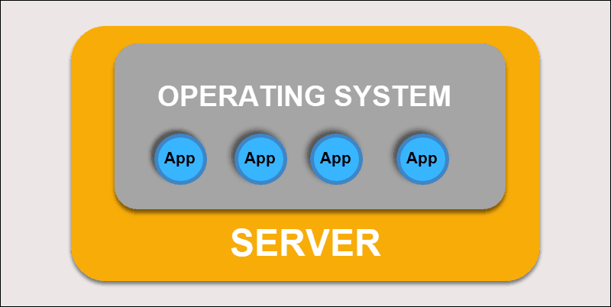
What is Container Deployment?
Traditional Deployment

Slide 166
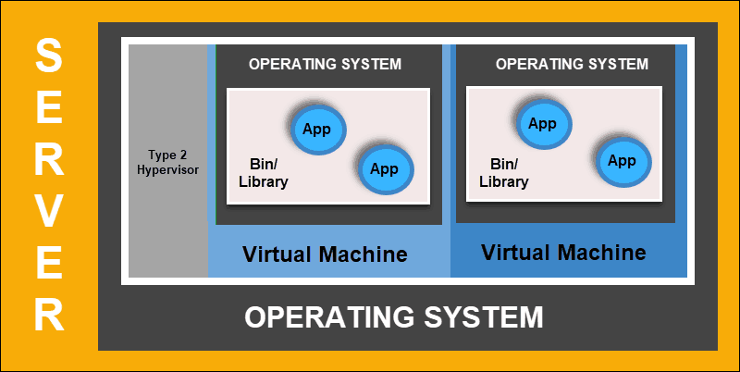
What is Container Deployment?
virtualized Deployment

Slide 167

What is Container Deployment?
ContainerDeployment

Slide 168

Docker and Kubernetes - Python

Slide 169


Docker and Kubernetes - Python
docker run -p 5000:8087 k8flask:latest

Slide 170

Docker and Kubernetes - Python
docker tag k8flask:latest eswaribala/ecommercecgirepo:p1
Docker push eswaribala/ecommercecgirepo:p1

Slide 171

Deployment file

Slide 172

Deployment file

Slide 173

Deployment file

Slide 174

Deployment file

Slide 175

Deployment file

Slide 176

Deployment file

Slide 177

Deployment file

Slide 178

Docker and Kubernetes - Python

Slide 179


Docker and Kubernetes - Python

Slide 180
Expose Service using External IP
kubectl expose deployment cgi-flask-deployment --type=LoadBalancer --name=flask-app-service-v1
Access service using service without port forwarding
http://localhost:8087

Slide 181

Expose Service using External IP

Slide 182

Expose Service using External IP

Slide 183
What is an Ingress?
In Kubernetes, an Ingress is an object that allows access to Kubernetes services from outside the Kubernetes cluster.
We configure access by creating a collection of rules that define which inbound connections reach which services.

Slide 184
What is an Ingress?
For example, you might want to send requests to example.com/api/v1/ to an api-v1 service, and requests to example.com/api/v2/ to the api-v2 service.
With an Ingress, we can easily set this up without creating a bunch of LoadBalancers or exposing each service on the Node.

Slide 185

Kubernetes Ingress vs LoadBalancer vs NodePort

Slide 186

Kubernetes Ingress vs LoadBalancer vs NodePort

Slide 187

Kubernetes Ingress vs LoadBalancer vs NodePort

Slide 188
Loadbalance and Routing - Ingress
ingress installation
kubectl apply -f https://raw.githubusercontent.com/kubernetes/ingress-nginx/controller-v0.41.2/deploy/static/provider/cloud/deploy.yaml
verify installation
kubectl get pods -n ingress-nginx -l app.kubernetes.io/name=ingress-nginx --watch

Slide 189
Loadbalance and Routing - Ingress
kubectl apply -f apple.yaml
kubectl apply -f banana.yaml
kubectl apply -f ingress.yaml
curl -kL http://localhost/apple
curl -kL http://localhost/banana

Slide 190
What is helm
In simple terms, Helm is a package manager for Kubernetes.
Helm is the K8s equivalent of yum or apt.
Helm deploys charts, which you can think of as a packaged application.
It is a collection of all your versioned, pre-configured application resources which can be deployed as one unit.
You can then deploy another version of the chart with a different set of configuration.

Slide 191
What is helm
Helm helps in three key ways:
Improves productivity
Reduces the complexity of deployments of microservices
Enables the adaptation of cloud native applications

Slide 192
What are Helm charts?
Helm Charts are simply Kubernetes YAML manifests combined into a single package that can be advertised to your Kubernetes clusters.
Once packaged, installing a Helm Chart into your cluster is as easy as running a single helm install, which really simplifies the deployment of containerized applications.

Slide 193
Helm Install
choco install kubernetes-helm
Or
https://github.com/helm/helm/releases
Unzip
Initialize helm using the helm init command.
Finally, add the repo of the helm chart using the below-given command.
helm repo add stable https://kubernetes-charts.storage.googleapis.com/
helm repo list

Slide 194
Deploy an Apache webserver using Helm
Location to search
helm repo add bitnami https://charts.bitnami.com/bitnami
Download apache
helm install my-apache bitnami/apache --version 8.0.2

Slide 195

Deploy an Apache webserver using Helm

Slide 196
Deploy an Apache webserver using Helm
helm list
helm upgrade my-apache bitnami/apache --version 8.0.3
Rollback
helm rollback my-apache 1
helm delete my-apache

Slide 197
How to Access Production-Ready Helm Charts
We can search public hubs for Charts that enable you to quickly deploy your desired application with a customizable configuration.
A Helm Chart doesn't just contain a static set of definitions.
Helm comes with capabilities to hook into any lifecycle state of a Kubernetes deployment.
This means during the installation or upgrade of an application, various actions can be executed like creating a database update before updating the actual database.

Slide 198
How to Access Production-Ready Helm Charts
Helm might be heavy for a simple container like a single node web server, but it’s very useful for more complex applications.
For example it works great for a distributed system like Kafka or Cassandra that usually runs on multiple distributed nodes on different datacenters.

Slide 199
Production-ready WordPress application
Containers that serve WordPress,
Instances of MariaDB for persistence and
Prometheus sidecar containers for each WordPress container to expose health metrics.

Slide 200
How to Deploy WordPress and MariaDB
helm repo add bitnami https://charts.bitnami.com/bitnami
helm install my-wordpress bitnami/wordpress --version 10.1.4

Slide 201
Loadbalance and Routing - Ingress
1. create first-app.yaml
2. create second-app.yaml
3. deploy them
4. helm repo add ingress-nginx https://kubernetes.github.io/ingress-nginx
5.helm repo update
6.helm install nginx-ingress ingress-nginx/ingress-nginx --set controller.publishService.enabled=true
7.watch the load balancer by running
kubectl --namespace default get services -o wide -w nginx-ingress-ingress-nginx-controller

Slide 202
Loadbalance and Routing - Ingress
Kubectl apply –f app-ingress.yaml
kubectl get ingress hello-kubernetes-ingress
kubectl describe ingress hello-kubernetes-ingress

Slide 203
What is a ConfigMap in Kubernetes?
A ConfigMap is a dictionary of configuration settings.
This dictionary consists of key-value pairs of strings.
Kubernetes provides these values to your containers.
Like with other dictionaries (maps, hashes, ...) the key lets you get and set the configuration value.

Slide 204
Why would you use a ConfigMap in Kubernetes?
Use a ConfigMap to keep your application code separate from your configuration.
It is an important part of creating a Twelve-Factor Application.
A ConfigMap stores configuration settings for your code. Store connection strings, public credentials, hostnames, and URLs in your ConfigMap.

Slide 205

How does a ConfigMap work?

Slide 206
ConfigMaps
ConfigMaps can be used to:
Populate the values of environment variables
Set command-line arguments in a container
Populate config files in a volume

Slide 207
Creating ConfigMaps from file
kubectl create configmap command to create configmaps easily from literal values, files, or directories.
kubectl create configmap configmap-example-1 --from-file=./config-map-data.txt
kubectl describe configmap/configmap-example-1
kubectl delete configmap/configmap-example-1

Slide 208
Create ConfigMaps from Literal Values
kubectl create configmap literal-config-1 --from-literal=literal-key1=value1 --from-literal=literal-key2=22
kubectl create configmap literal-config-mysql --from-literal=literal-port=3306 --from-literal=literal-host=127.0.0.1 --from-literal=literal-user=root --from-literal=liter-password=password

Slide 209
Create ConfigMaps from-literal
kubectl create configmap literal-config-1 --from-literal=city=London --from-literal=population=millions

Slide 210

Create ConfigMaps from Directories
kubectl create configmap from-folder-configmap --from-file=test
kubectl describe configmap/from-folder-configmap

Slide 211
Use Configmap as Env variable
kubectl get configmaps literal-config-1 -o yaml
kubectl create -f Config-Map-demo1.yaml

Slide 212

Use Configmap as Env variable

Slide 214

Docker-Desktop wsl2 Multinode cluster

Slide 215
Docker-Desktop wsl2 Multinode cluster
curl.exe -Lo kind-windows-amd64.exe https://kind.sigs.k8s.io/dl/v0.10.0/kind-windows-amd64
copy .\kind-windows-amd64.exe d:\kube\kind.exe
Go to d:\kube
kind create cluster # Default cluster context name is `kind`.
kind create cluster --name kind-2

Slide 216

Docker-Desktop wsl2 Multinode cluster

Slide 217

Docker-Desktop wsl2 Multinode cluster

Slide 218

Docker-Desktop wsl2 Multinode cluster

Slide 219

Docker-Desktop wsl2 Multinode cluster

Slide 220
Kubernetes multiple control planes
# a cluster with 3 control-plane nodes and 3 workers
kind: Cluster
apiVersion: kind.x-k8s.io/v1alpha4
nodes:
- role: control-plane
- role: control-plane
- role: control-plane
- role: worker
- role: worker
- role: worker

Slide 221
Kubernetes multiple control planes
kind: Cluster
apiVersion: kind.x-k8s.io/v1alpha4
nodes:
- role: control-plane
extraPortMappings:
- containerPort: 80
hostPort: 80
listenAddress: "0.0.0.0" # Optional, defaults to "0.0.0.0"
protocol: udp # Optional, defaults to tcp

Slide 222

Kubernetes multiple control planes

Slide 223

Kubernetes multiple control planes

Slide 224
Multi node cluster dashboard
Repeat dashboard installation steps for every cluster

Slide 225
Kubernetes Deployment Policies
recreate: terminate the old version and release the new one
ramped: release a new version on a rolling update fashion, one after the other
blue/green: release a new version alongside the old version then switch traffic
canary: release a new version to a subset of users, then proceed to a full rollout
a/b testing: release a new version to a subset of users in a precise way (HTTP headers, cookie, weight, etc.).
A/B testing is really a technique for making business decisions based on statistics but we will briefly describe the process.
This doesn’t come out of the box with Kubernetes, it implies extra work to setup a more advanced infrastructure (Istio, Linkerd, Traefik, custom nginx/haproxy, etc).

Slide 226
Recreate - best for development environment
spec:
replicas: 3
strategy:
type: Recreate

Slide 227
Recreate - best for development environment
The recreate strategy is a dummy deployment which consists of shutting down version A then deploying version B after version A is turned off.
This technique implies downtime of the service that depends on both shutdown and boot duration of the application.

Slide 228

Recreate - best for development environment

Slide 229
Recreate - best for development environment
Deploy the first application
$ kubectl apply -f app-v1.yaml
# Test if the deployment was successful
Kubectl logs deploy/my-app
# Then deploy version 2 of the application
$ kubectl apply -f app-v2.yaml
Kubectl logs deploy/my-app

Slide 230
Recreate - best for development environment
Pro:
application state entirely renewed
Cons:
downtime that depends on both shutdown and boot duration of the application

Slide 231

Ramped - slow rollout
A ramped deployment updates pods in a rolling update fashion, a secondary ReplicaSet is created with the new version of the application, then the number of replicas of the old version is decreased and the new version is increased until the correct number of replicas is reached.

Slide 232
Ramped – Slow Rollout
spec:
replicas: 3
strategy:
type: RollingUpdate
rollingUpdate:
maxSurge: 2 # how many pods we can add at a time
maxUnavailable: 0 # maxUnavailable define how many pods can be unavailable
# during the rolling update

Slide 233
Ramped- best for development environment
Deploy the first application
$ kubectl apply -f app-v1.yaml
# Test if the deployment was successful
Kubectl logs deploy/my-app
# Then deploy version 2 of the application
$ kubectl apply -f app-v2.yaml
Kubectl logs deploy/my-app

Slide 234
Ramped- best for development environment
# In case you discover some issue with the new version, you can undo the
# rollout
$ kubectl rollout undo deploy my-app
# If you can also pause the rollout if you want to run the application for a
# subset of users
$ kubectl rollout pause deploy my-app
# Then if you are satisfy with the result, rollout
$ kubectl rollout resume deploy my-app

Slide 235
Ramped- best for development environment
When setup together with horizontal pod autoscaling it can be handy to use a percentage based value instead of a number for maxSurge and maxUnavailable.
If you trigger a deployment while an existing rollout is in progress, the deployment will pause the rollout and proceed to a new release by overriding the rollout.

Slide 236
Ramped- best for development environment
Pro:
version is slowly released across instances
convenient for stateful applications that can handle rebalancing of the data
Cons:
rollout/rollback can take time
supporting multiple APIs is hard
no control over traffic

Slide 237
Blue/Green - best to avoid API versioning issues
A blue/green deployment differs from a ramped deployment because the "green" version of the application is deployed alongside the "blue" version.
After testing that the new version meets the requirements, we update the Kubernetes Service object that plays the role of load balancer to send traffic to the new version by replacing the version label in the selector field.

Slide 238

Blue/Green - best to avoid API versioning issues

Slide 239
ReplicaSet
A ReplicaSet's purpose is to maintain a stable set of replica Pods running at any given time.
As such, it is often used to guarantee the availability of a specified number of identical Pods.

Slide 240
ReplicaSet
A ReplicaSet is defined with fields, including a selector that specifies how to identify Pods it can acquire, a number of replicas indicating how many Pods it should be maintaining, and a pod template specifying the data of new Pods it should create to meet the number of replicas criteria.
A ReplicaSet then fulfills its purpose by creating and deleting Pods as needed to reach the desired number.
When a ReplicaSet needs to create new Pods, it uses its Pod template.

Slide 241
ReplicaSet
When to use a ReplicaSet
A ReplicaSet ensures that a specified number of pod replicas are running at any given time.
However, a Deployment is a higher-level concept that manages ReplicaSets and provides declarative updates to Pods along with a lot of other useful features.
Therefore, we recommend using Deployments instead of directly using ReplicaSets, unless you require custom update orchestration or don't require updates at all.

Slide 242

kubectl get rs

Slide 243
What is a Deployment?
A Deployment provides declarative updates for Pods and Replica Sets (the next-generation Replication Controller).
You only need to describe the desired state in a Deployment object, and the Deployment controller will change the actual state to the desired state at a controlled rate for you.
You can define Deployments to create new resources, or replace existing ones by new ones.

Slide 244
What is a Deployment?
A typical use case is:
Create a Deployment to bring up a Replica Set and Pods.
Check the status of a Deployment to see if it succeeds or not.
Later, update that Deployment to recreate the Pods (for example, to use a new image).
Rollback to an earlier Deployment revision if the current Deployment isn't stable.
Pause and resume a Deployment.

Slide 245
Creating a Deployment
Here is an example Deployment. It creates a Replica Set to bring up 3 nginx Pods.
{% include code.html language="yaml" file="nginx-deployment.yaml" ghlink="/docs/concepts/workloads/controllers/nginx-deployment.yaml" %}
Run the example by downloading the example file and then running this command:
$ kubectl create -f docs/user-guide/nginx-deployment.yaml --record
deployment "nginx-deployment" created

Slide 246
Creating a Deployment
$ kubectl get deployments
NAME DESIRED CURRENT UP-TO-DATE AVAILABLE AGE
nginx-deployment 3 0 0 0 1s
$ kubectl get rs
NAME DESIRED CURRENT READY AGE
nginx-deployment-2035384211 3 3 0 18s

Slide 247
Creating a Deployment
$ kubectl get pods --show-labels

Slide 248
Rolling Back a Deployment
Sometimes you may want to rollback a Deployment; for example, when the Deployment is not stable, such as crash looping.
By default, two previous Deployment's rollout history are kept in the system so that you can rollback anytime you want.

Slide 249
Rolling Back a Deployment
Note: a Deployment's revision is created when a Deployment's rollout is triggered.
This means that the new revision is created if and only if the Deployment's pod template (i.e. .spec.template) is changed, e.g. updating labels or container images of the template.
Other updates, such as scaling the Deployment, will not create a Deployment revision -- so that we can facilitate simultaneous manual- or auto-scaling.
This implies that when you rollback to an earlier revision, only the Deployment's pod template part will be rolled back.

Slide 250
Rolling Back a Deployment
kubectl set image deployment/nginx-deployment nginx=nginx:1.91
kubectl rollout status deployments nginx-deployment
kubectl rollout history deployment/nginx-deployment
kubectl rollout history deployment/nginx-deployment --revision=2

Slide 251
Scaling a Deployment
kubectl scale deployment nginx-deployment --replicas 10
kubectl get deploy
kubectl set image deploy/nginx-deployment nginx=nginx:sometag

Slide 252
Working with Kubernetes Objects
Kubernetes objects are persistent entities in the Kubernetes system.
Kubernetes uses these entities to represent the state of your cluster.
Specifically, they can describe:
What containerized applications are running (and on which nodes)
The resources available to those applications
The policies around how those applications behave, such as restart policies, upgrades, and fault-tolerance

Slide 253
Init containers
A Pod can have multiple containers running apps within it, but it can also have one or more init containers, which are run before the app containers are started.
Init containers are exactly like regular containers, except:
Init containers always run to completion.
Each init container must complete successfully before the next one starts.
If a Pod's init container fails, Kubernetes repeatedly restarts the Pod until the init container succeeds.
However, if the Pod has a restartPolicy of Never, Kubernetes does not restart the Pod.

Slide 254
Differences from regular containers
Init containers support all the fields and features of app containers, including resource limits, volumes, and security settings.
However, the resource requests and limits for an init container are handled differently, as documented in Resources.
Also, init containers do not support lifecycle, livenessProbe, readinessProbe, or startupProbe because they must run to completion before the Pod can be ready.

Slide 255

Create a Pod that has an Init Container

Slide 256
Working with Kubernetes Objects
To work with Kubernetes objects--whether to create, modify, or delete them--you'll need to use the Kubernetes API.
When you use the kubectl command-line interface, for example, the CLI makes the necessary Kubernetes API calls for you.

Slide 257
Object Spec and Status
Almost every Kubernetes object includes two nested object fields that govern the object's configuration: the object spec and the object status.
For objects that have a spec, you have to set this when you create the object, providing a description of the characteristics you want the resource to have: its desired state.
The status describes the current state of the object, supplied and updated by the Kubernetes system and its components.
The Kubernetes control plane continually and actively manages every object's actual state to match the desired state you supplied.

Slide 258
Object Spec and Status
For example: in Kubernetes, a Deployment is an object that can represent an application running on your cluster.
When you create the Deployment, you might set the Deployment spec to specify that you want three replicas of the application to be running.
The Kubernetes system reads the Deployment spec and starts three instances of your desired application--updating the status to match your spec.
If any of those instances should fail (a status change), the Kubernetes system responds to the difference between spec and status by making a correction--in this case, starting a replacement instance.

Slide 259
Describing a Kubernetes object
Deployment.yaml
apiVersion - Which version of the Kubernetes API you're using to create this object
kind - What kind of object you want to create
metadata - Data that helps uniquely identify the object, including a name string, UID, and optional namespace
spec - What state you desire for the object

Slide 260
Network Terms
Layer 2 Networking
Layer 2 is the data link layer providing Node-to-Node data transfer.
It defines the protocol to establish and terminate a connection between two physically connected devices. It also defines the protocol for flow control between them.

Slide 261
Network Terms
Layer 4 Networking
The transport layer controls the reliability of a given link through flow control. In TCP/IP, this layer refers to the TCP protocol for exchanging data over an unreliable network.

Slide 262
Network Terms
Layer 7 Networking
The application layer is the layer closest to the end user, which means both the application layer and the user interact directly with the software application.
This layer interacts with software applications that implement a communicating component. Typically, Layer 7 Networking refers to HTTP.

Slide 263
Network Terms
NAT — Network Address Translation
NAT or network address translation is an IP-level remapping of one address space into another. The mapping happens by modifying network address information in the IP header of packets while they are in transit across a traffic routing device.

Slide 264
Network Terms
SNAT — Source Network Address Translation
SNAT simply refers to a NAT procedure that modifies the source address of an IP packet. This is the typical behaviour for the NAT described above.
DNAT — Destination Network Address Translation
DNAT refers to a NAT procedure that modifies the destination address of an IP packet. DNAT is used to publish a service resting in a private network to a publicly addressable IP address.

Slide 265
Network Terms
Network Namespace
In networking, each machine (real or virtual) has an Ethernet device (that we will refer to as eth0).
All traffic flowing in and out of the machine is associated with that device.
In truth, Linux associates each Ethernet device with a network namespace — a logical copy of the entire network stack, with its own routes, firewall rules, and network devices.
Initially, all the processes share the same default network namespace from the init process, called the root namespace.
By default, a process inherits its network namespace from its parent and so, if you don’t make any changes, all network traffic flows through the Ethernet device specified for the root network namespace.

Slide 266
Network Terms
veth — Virtual Ethernet Device Pairs
Computer systems typically consist of one or more networking devices — eth0, eth1, etc — that are associated with a physical network adapter which is responsible for placing packets onto the physical wire.
Veth devices are virtual network devices that are always created in interconnected pairs.
They can act as tunnels between network namespaces to create a bridge to a physical network device in another namespace, but can also be used as standalone network devices.

Slide 267
Network Terms
bridge — Network Bridge
A network bridge is a device that creates a single aggregate network from multiple communication networks or network segments.
Bridging connects two separate networks as if they were a single network.
Bridging uses an internal data structure to record the location that each packet is sent to as a performance optimization.

Slide 268
Network Terms
iptables — Packet Mangling Tool
iptables is a program that allows a Linux system administrator to configure the netfilter and the chains and rules it stores.
Each rule within an IP table consists of a number of classifiers (iptables matches) and one connected action (iptables target).

Slide 269
Network Terms
IPVS — IP Virtual Server
IPVS implements transport-layer load balancing as part of the Linux kernel.
IPVS is a tool similar to iptables. It is based on the Linux kernel’s netfilter hook function, but uses a hash table as the underlying data structure.
That means, when compared to iptables, IPVS redirects traffic much faster, has much better performance when syncing proxy rules, and provides more load balancing algorithms.

Slide 270
Network Terms
DNS — The Domain Name System
The Domain Name System (DNS) is a decentralized naming system for associating system names with IP addresses.
It translates domain names to numerical IP addresses for locating computer services.

Slide 271
The Kubernetes Networking Model
Kubernetes makes opinionated choices about how Pods are networked. In particular, Kubernetes dictates the following requirements on any networking implementation:
all Pods can communicate with all other Pods without using network address translation (NAT).
all Nodes can communicate with all Pods without NAT.
the IP that a Pod sees itself as is the same IP that others see it as.

Slide 272
The Kubernetes Networking Model
Given these constraints, we are left with four distinct networking problems to solve:
Container-to-Container networking
Pod-to-Pod networking
Pod-to-Service networking
Internet-to-Service networking

Slide 273

Container-to-Container Networking
Typically, we view network communication in a virtual machine as interacting directly with an Ethernet device,

Slide 274
Container-to-Container Networking
Linux, each running process communicates within a network namespace that provides a logical networking stack with its own routes, firewall rules, and network devices.
In essence, a network namespace provides a brand new network stack for all the processes within the namespace.
As a Linux user, network namespaces can be created using the ip command.
For example, the following command will create a new network namespace called ns1.
ip netns add ns1

Slide 275
Container-to-Container Networking
When the namespace is created, a mount point for it is created under /var/run/netns, allowing the namespace to persist even if there is no process attached to it.
You can list available namespaces by listing all the mount points under /var/run/netns, or by using the ip command.
$ ls /var/run/netns
ns1
$ ip netns
ns1

Slide 276


Slide 277

Root Network Namespace
By default, Linux assigns every process to the root network namespace to provide access to the external world

Slide 278
Network Namespace/pod
In terms of Docker constructs, a Pod is modelled as a group of Docker containers that share a network namespace.
Containers within a Pod all have the same IP address and port space assigned through the network namespace assigned to the Pod, and can find each other via localhost since they reside in the same namespace.
We can create a network namespace for each Pod on a virtual machine.
This is implemented, using Docker, as a “Pod container” which holds the network namespace open while “app containers” (the things the user specified) join that namespace with Docker’s –net=container: function.

Slide 279

Network Namespace/pod
Applications within a Pod also have access to shared volumes, which are defined as part of a Pod and are made available to be mounted into each application’s filesystem.

Slide 280
Pod-to-Pod Networking
In Kubernetes, every Pod has a real IP address and each Pod communicates with other Pods using that IP address.
The task at hand is to understand how Kubernetes enables Pod-to-Pod communication using real IPs, whether the Pod is deployed on the same physical Node or different Node in the cluster.
We are considering that pods reside on the same machine to avoid the complications of going over the internal network to communicate across Nodes.

Slide 281
Pod-to-Pod Networking
From the Pod’s perspective, it exists in its own Ethernet namespace that needs to communicate with other network namespaces on the same Node.
Namespaces can be connected using a Linux Virtual Ethernet Device or veth pair consisting of two virtual interfaces that can be spread over multiple namespaces.
To connect Pod namespaces, we can assign one side of the veth pair to the root network namespace, and the other side to the Pod’s network namespace.
Each veth pair works like a patch cable, connecting the two sides and allowing traffic to flow between them.
This setup can be replicated for as many Pods as we have on the machine.

Slide 282

Pod-to-Pod Networking

Slide 283
Pod-to-Pod Networking
At this point, we’ve set up the Pods to each have their one network namespace so that they believe they have their own Ethernet device and IP address, and they are connected to the root namespace for the Node.
Now, we want the Pods to talk to each other through the root namespace, and for this we use a network bridge.

Slide 284
Pod-to-Pod Networking
A Linux Ethernet bridge is a virtual Layer 2 networking device used to unite two or more network segments, working transparently to connect two networks together.
The bridge operates by maintaining a forwarding table between sources and destinations by examining the destination of the data packets that travel through it and deciding whether or not to pass the packets to other network segments connected to the bridge.
The bridging code decides whether to bridge data or to drop it by looking at the MAC-address unique to each Ethernet device in the network.

Slide 285
Pod-to-Pod Networking
Bridges implement the ARP protocol to discover the link-layer MAC address associated with a given IP address.
When a data frame is received at the bridge, the bridge broadcasts the frame out to all connected devices (except the original sender) and the device that responds to the frame is stored in a lookup table.
Future traffic with the same IP address uses the lookup table to discover the correct MAC address to forward the packet to.

Slide 286

Pod-to-Pod Networking

Slide 287

Life of a Packet

Slide 288
Life of a Packet
Pod 1 sends a packet to its own Ethernet device eth0 which is available as the default device for the Pod.
For Pod 1, eth0 is connected via a virtual Ethernet device to the root namespace, veth0 (1).
The bridge cbr0 is configured with veth0 a network segment attached to it.
Once the packet reaches the bridge, the bridge resolves the correct network segment to send the packet to — veth1 using the ARP protocol (3).

Slide 289
Life of a Packet
When the packet reaches the virtual device veth1, it is forwarded directly to Pod 2’s namespace and the eth0 device within that namespace (4).
Throughout this traffic flow, each Pod is communicating only with eth0 on localhost and the traffic is routed to the correct Pod.
The development experience for using the network is the default behaviour that a developer would expect.

Slide 290
Life of a Packet
Kubernetes’ networking model dictates that Pods must be reachable by their IP address across Nodes.
That is, the IP address of a Pod is always visible to other Pods in the network, and each Pod views its own IP address as the same as how other Pods see it.
We now turn to the problem of routing traffic between Pods on different Nodes.

Slide 291

Life of a packet: Pod-to-Pod, across Nodes

Slide 292
Pod-to-Service Networking
A Kubernetes Service manages the state of a set of Pods, allowing you to track a set of Pod IP addresses that are dynamically changing over time.
Services act as an abstraction over Pods and assign a single virtual IP address to a group of Pod IP addresses.
Any traffic addressed to the virtual IP of the Service will be routed to the set of Pods that are associated with the virtual IP.
This allows the set of Pods associated with a Service to change at any time — clients only need to know the Service’s virtual IP, which does not change.

Slide 293
Pod-to-Service Networking
When creating a new Kubernetes Service, a new virtual IP (also known as a cluster IP) is created on your behalf.
Anywhere within the cluster, traffic addressed to the virtual IP will be load-balanced to the set of backing Pods associated with the Service.
In effect, Kubernetes automatically creates and maintains a distributed in-cluster load balancer that distributes traffic to a Service’s associated healthy Pods.

Slide 294

Pod to Service

Slide 295
Pod to Service
The packet first leaves the Pod through the eth0 interface attached to the Pod’s network namespace (1).
Then it travels through the virtual Ethernet device to the bridge (2).
The ARP protocol running on the bridge does not know about the Service and so it transfers the packet out through the default route — eth0 (3).
Here, something different happens. Before being accepted at eth0, the packet is filtered through iptables.
After receiving the packet, iptables uses the rules installed on the Node by kube-proxy in response to Service or Pod events to rewrite the destination of the packet from the Service IP to a specific Pod IP (4).

Slide 296
Pod to Service
The packet is now destined to reach Pod 4 rather than the Service’s virtual IP.
The Linux kernel’s conntrack utility is leveraged by iptables to remember the Pod choice that was made so future traffic is routed to the same Pod (barring any scaling events).
In essence, iptables has done in-cluster load balancing directly on the Node. Traffic then flows to the Pod using the Pod-to-Pod routing we’ve already examined (5).

Slide 297

Service to POD

Slide 298
Using DNS
Kubernetes can optionally use DNS to avoid having to hard-code a Service’s cluster IP address into your application.
Kubernetes DNS runs as a regular Kubernetes Service that is scheduled on the cluster.
It configures the kubelets running on each Node so that containers use the DNS Service’s IP to resolve DNS names.
Every Service defined in the cluster (including the DNS server itself) is assigned a DNS name.
DNS records resolve DNS names to the cluster IP of the Service or the IP of a POD, depending on your needs.
SRV records are used to specify particular named ports for running Services.

Slide 299
Using DNS
A DNS Pod consists of three separate containers:
kubedns: watches the Kubernetes master for changes in Services and Endpoints, and maintains in-memory lookup structures to serve DNS requests.
dnsmasq: adds DNS caching to improve performance.
sidecar: provides a single health check endpoint to perform healthchecks for dnsmasq and kubedns.

Slide 300
Ingress — Routing Internet traffic to Kubernetes
Ingress — getting traffic into your cluster — is a problem to solve.
Again, this is specific to the network you are running, but in general, Ingress is divided into two solutions that work on different parts of the network stack:
(1) a Service LoadBalancer and
(2) an Ingress controller.

Slide 301
Layer 4 Ingress: LoadBalancer
When you create a Kubernetes Service you can optionally specify a LoadBalancer to go with it.
The implementation of the LoadBalancer is provided by a cloud controller that knows how to create a load balancer for your service.
Once your Service is created, it will advertise the IP address for the load balancer.
As an end user, you can start directing traffic to the load balancer to begin communicating with your Service

Slide 302


Slide 303

Ingress Controller

Slide 304
Docker Security
Docker container security is more complicated, largely because a typical Docker environment has many more moving parts. Those parts include:
Your containers. You probably have multiple Docker container images, each hosting individual microservices. You probably also have multiple instances of each image running at a given time. Each of those images and instances needs to be secured and monitored separately.
The Docker daemon, which needs to be secured to keep the containers it hosts safe.
The host server, which could be bare metal or a virtual machine.
If you host your containers in the cloud using a service like ECS, that is another layer to secure.
Overlay networks and APIs that facilitate communication between containers.
Data volumes or other storage systems that exist externally from your containers

Slide 305

Docker Security

Slide 306
Docker Security
Whether image comes from an official one, such as NGINX, Redis, Ubuntu, or Alpine Linux; or one from a total stranger.
USE PRIVATE OR TRUSTED REPOSITORIES
In Docker Hub, the images are always scanned and reviewed by Docker’s Security Scanning Service.
Docker Cloud and Docker Hub can scan images in private repositories to verify that they are free from known security vulnerabilities or exposures, and report the results of the scan for each image tag.

Slide 307
Docker Security
USE DOCKER CONTENT TRUST
Before a publisher pushes an image to a remote registry, Docker Engine signs the image locally with the publisher’s private key.
When you later pull this image, Docker Engine uses the publisher’s public key to verify that the image you are about to run is exactly what the publisher created, has not been tampered with and is up to date.

Slide 308
Docker Security
Docker Bench Security
The tool was based on the recommendations in the CIS Docker 1.13 Benchmark, and run checks against the following six areas:
Host configuration
Docker daemon configuration
Docker daemon configuration files
Container images and build files
Container runtime
Docker security operations

Slide 309

Docker Security

Slide 310

Docker Security

Slide 311
Docker Security
With respect to Docker focus on two points:
Containers running in privileged mode
Excess privileges used by containers
Starting with the first point, you can run a Docker container with the --privileged switch.
What this does is give extended privileges to this container.
It gives all capabilities to the container, and it also lifts all the limitations enforced by the device cgroup controller.
In other words, the container can then do almost everything that the host can do.
This flag exists to allow special use-cases, like running Docker within Docker.

Slide 312
Docker Security
DROP UNNECESSARY PRIVILEGES AND CAPABILITIES.
Consider these questions:
What kind of network connectivity does your application need?
Does it need raw socket access?
Does it need to send and receive UDP requests? If not, then deny it those capabilities.
If not, then deny it those capabilities.
To do so, make use of the --cap-drop and --cap-add switches.

Slide 313
Docker Security
docker run \
--cap-drop SETPCAP \
--cap-drop NET_BIND_SERVICE \
--cap-add SYS_MODULE \
-ti /bin/sh

Slide 314
Docker Security
System Security
While Docker is increasingly very safe by default, thanks to having namespaces and cgroups as its foundation, you don’t need to only rely on these features.
You can go further and make use of other Linux security options, such as AppArmor, SELinux, grsecurity and Seccomp.

Slide 315
Docker Security
App Armor is a Linux kernel security module that allows the system administrator to restrict programs’ capabilities with per-program profiles.
Profiles can allow capabilities like network access, raw socket access, and the permission to read, write, or execute files on matching paths.

Slide 316
Docker Security
Limit Available Resource Consumption
What does your application need?
Is it a quite light application, requiring no more than
50MB of memory?
Then why let it access more?
Does it perform more intensive processing, requiring 4+ CPUs?
Then allow it to have access to that.

Slide 317
Docker Security
Assuming that analysis, profiling, and benchmarking are part of your continuous development processes, then this information will be readily available.
As a result, when deploying your containers, ensure that they only have the resources that they need.

Slide 318
Docker Security
To do so, use the applicable docker run switches, such as the following:
-m / --memory: Set a memory limit --memory-reservation: Set a soft memory limit
--kernel-memory: Set a kernel memory limit
--cpus: Limit the number of CPUs
--device-read-bps: Limit the read rate from a device

Slide 319
Docker Security
Large Attack Surfaces
As Docker allows you to create and deploy applications so quickly — as well as to destroy them with equal ease — it can be difficult to know exactly what applications your organization has deployed.
Given that, the potential of a large attack surface grows. Not sure about the deployment statistics of your organization?
To help you out, ask yourself the following questions:
What applications are currently deployed by your organization?
Who deployed them?

Slide 320
Docker Security
When were they deployed?
Why were they deployed?
How long are they to be deployed for?
Who’s responsible for them?
When was a security scan last run on them?

Slide 321
Docker Security
IMPLEMENT AN AUDIT TRAIL WITH PROPER LOGGING
As with audit trails within applications, such as when a user created their account when it was activated, and when the user last updated their password, and those more widely within organizations, consider implementing an audit trail around every container that your organization creates and deploys.

Slide 322
Configuring Certificate-Based Mutual Authentication with Kubernetes Ingress-Nginx
Mutual Authentication
Mutual authentication is also known as 2-way authentication. It is a process in which both the client and server verify each others identity via a Certificate Authority.
Mutual SSL authentication or certificate based mutual authentication refers to two parties authenticating each other through verifying the provided digital certificate so that both parties are assured of the others’ identity.

Slide 323

Configuring Certificate-Based Mutual Authentication with Kubernetes Ingress-Nginx

Slide 324
Setting Up Mutual Authentication
Creating the Certificates
CommonName(CN): Identifies the hostname or owner associated with the certificate.
Certificate Authority(CA): A trusted 3rd party that issues Certificates. Usually you would obtain this from a trusted source, but for this example we will just create one. The CN is usually the name of the issuer.
Server Certificate: A Certificate used to identify the server. The CN here is the hostname of the server. The Server Certificate is valid only if it is installed on a server where the hostname matches the CN.
Client Certificate: A Certificate used to identify a client/user. The CN here is usually the name of the client/user.

Slide 325
Setting Up Mutual Authentication
Generate the CA Key and Certificate
$ openssl req -x509 -sha256 -newkey rsa:4096 -keyout ca.key -out ca.crt -days 356 -nodes -subj '/CN=Fern Cert Authority'
# Generate the Server Key, and Certificate and Sign with the CA Certificate
$ openssl req -new -newkey rsa:4096 -keyout server.key -out server.csr -nodes -subj '/CN=meow.com'
$ openssl x509 -req -sha256 -days 365 -in server.csr -CA ca.crt -CAkey ca.key -set_serial 01 -out server.crt
# Generate the Client Key, and Certificate and Sign with the CA Certificate
$ openssl req -new -newkey rsa:4096 -keyout client.key -out client.csr -nodes -subj '/CN=Fern'
$ openssl x509 -req -sha256 -days 365 -in client.csr -CA ca.crt -CAkey ca.key -set_serial 02 -out client.crt

Slide 326
Setting Up Mutual Authentication
Creating the Kubernetes Secrets
$ kubectl create secret generic my-certs --from-file=tls.crt=server.crt --from-file=tls.key=server.key --from-file=ca.crt=ca.crt
$ kubectl get secret my-certs
NAME TYPE DATA AGE
my-certs Opaque 3 1m

Slide 327
Deploying an Application with Mutual Authentication
Refer docker commands.txt

Slide 328
TLS and mutual authentication
https://kubernetes.io/docs/tasks/tls/managing-tls-in-a-cluster/

Slide 329
Create Secret
https://kubernetes.io/docs/tasks/administer-cluster/encrypt-data/

Slide 330
Overview of RBAC concepts in Kubernetes
The RBAC model in Kubernetes is based on three elements:
Roles: definition of the permissions for each Kubernetes resource type
Subjects: users (human or machine users) or groups of users
RoleBindings: definition of what Subjects have which Roles

Slide 331

Pod has group of containers that are run on the same host. So, if we regularly deploy single containers, then our container and the pod will be one and the same.

Slide 332

Representation Of Kubernetes Cluster

Slide 333

Different types of services in Kubernetes

Slide 334

Minikube –p cluster1 dashboard

Slide 335

Openshift
Openshift is built on top of kubernetes. Openshift project is maintained by Redhat. It has both open source (openshift orgin) and enterprise version (openshift container platform).
Along with core Kubernetes features, it offers out of the box components for container management and orchestration.

